Slide 1

Quantum Communication
Part 2
Aditi
Harish-Chandra Research Institute, India

Slide 2
Outline
Classical info
transmission
Communication
Without security
Quantum state
transmission
Communication
Secure Communication
Quantum Cryptography

Slide 3
DC Capacity:
Known/Unknown
Single Sender – Single Receiver
Many Senders – Single Receiver
Solved ☺

Slide 4
Dense Coding Network 3

Slide 5

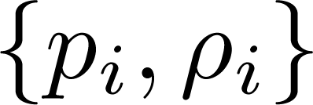
Distributed DC: Two receivers
Bob (B₁)
Alice (A₁)
Alice (A₂)
Bob (B₂)

Slide 6
Distributed DC: Two receivers
Bob (B₁)
i₁
Alice (A₁)
LOCC
i₂
Alice (A₂)
Bob (B₂)

Slide 7
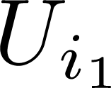
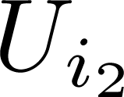
Distributed DC: Two receivers
Bob (B₁)
Alice (A₁)
Alice (A₂)
Bob (B₂)

Slide 8
Distributed DC: Two receivers
Bob (B₁)
Alice (A₁)
Alice (A₂)
Bob (B₂)
Alices send her particles to Bobs

Slide 9
Distributed DC: Two receivers
Bob (B₁)
Bob (B₂)
Bobs task: gather info abt i_{k} by LOCC

Slide 10
Distributed DC: Two receivers
Bob (B₁)
LOCC
Bob (B₂)
Bobs task: gather info abt i_{k} by LOCC

Slide 11

Distributed DC: Two receivers
C = Max

Slide 12

Distributed DC: Two receivers
C = Max
Max
LOCC Holevo bound
Maximization over all encodings i.e. over all {p_{i,} U_{i} }

Slide 13
Distributed DC: Two receivers
C = Max
Max
LOCC Holevo bound
Maximization over all encodings i.e. over all {p_{i,} U_{i} }
Badziag, Horodecki, ASD, Sen, PRL’03

Slide 14
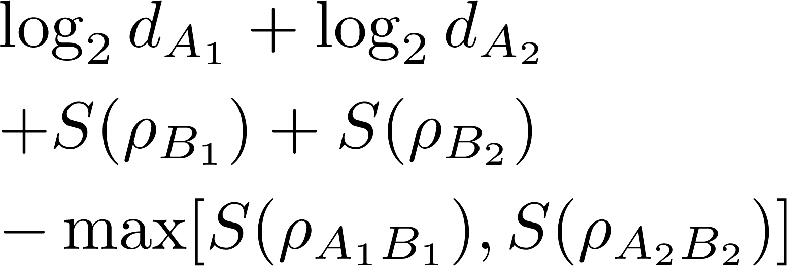
Distributed DC: Two receivers
Bruss, D’Ariano, Lewenstein, Macchiavello, ASD, Sen, PRL’ 04
C = Max
Max
LOCC Holevo bound
Maximization over all encodings i.e. over all {p_{i,} U_{i} }

Slide 15
DC Capacity:
Known/Unknown
Single Sender – Single Receiver
Many Senders – Single Receiver
Solved ☺

Slide 16
DC Capacity:
Known/Unknown
Single Sender – Single Receiver
Many Senders – Single Receiver
Solved ☺
Many Senders – Two Receivers

Slide 17
DC Capacity:
Known/Unknown
Single Sender – Single Receiver
Many Senders – Single Receiver
Solved ☺
Many Senders – Two Receivers
Partially Solved

Slide 18
DC Capacity:
Known/Unknown
Single Sender – Single Receiver
Many Senders – Single Receiver
Solved ☺
Many Senders – Two Receivers
Partially Solved
Many Senders – Many Receivers
Not Solved ☹

Slide 19
Outline
Classical info
transmission
Communication
Without security
Quantum state
transmission
Communication
Secure Communication
Quantum Cryptography

Slide 20
Quantum Dense Coding
Task: Classical info
transmission
Quantum Dense Coding

Slide 21
Quantum Dense Coding
Task: Classical info
transmission
Medium: Quantum State
Quantum Dense Coding

Slide 22
Quantum Dense Coding
Task: Classical info
transmission
Medium: Quantum State
Task: Quantum state/info
transmission
Quantum Dense Coding
Task: quantum state/info
transmission

Slide 23
Quantum Dense Coding
Task: Classical info
transmission
Medium: Quantum State
Task: Quantum state/info
transmission
Medium: Quantum State
Quantum Dense Coding

Slide 24
Task: Classical info
transmission
Medium: Quantum State
Task: Quantum state/info
transmission
Medium: Quantum State
Quantum Dense Coding
Quantum Teleportation

Slide 25
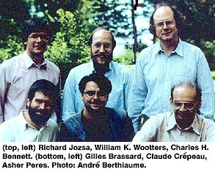
Quantum Teleportation
Bennett, Brassard, Crepeau, Jozsa, Peres, Wootters, PRL 1993

Slide 26
Quantum Teleportation
Task: Sending arbitrary quantum state

Slide 27

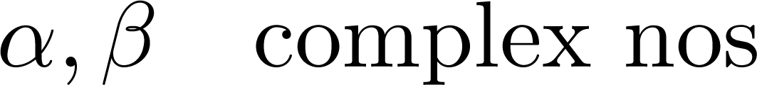
Quantum Teleportation
Task: Sending

Slide 28
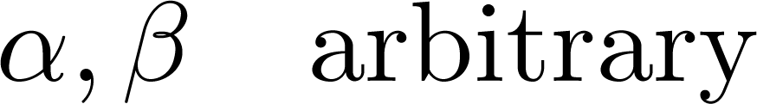
Quantum Teleportation
Task: Sending

Slide 29
Quantum Teleportation
Task: Sending
Classical: Infinite communication

Slide 30
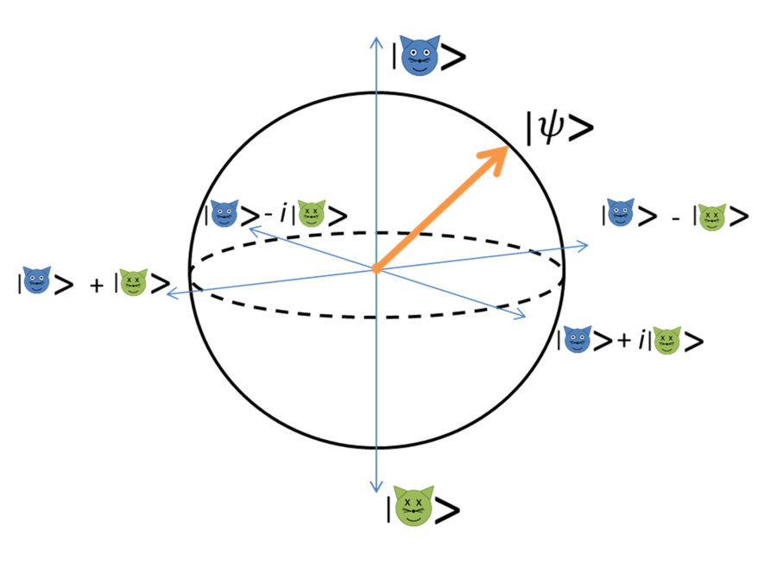
Quantum Teleportation
Task: Sending
Classical: Infinite communication

Slide 31
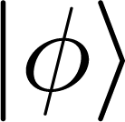
Quantum Teleportation
Alice
Bob
in
A
B

Slide 32
Quantum Teleportation
Alice
Bob
in
A
B
Alice performs measurements on “in’’ and A

Slide 33
Quantum Teleportation
Alice
Bob
After measurement
in
A
B

Slide 34
Quantum Teleportation
Alice
Bob
After measurement
in
A
B
2 bits of classical comm.
sent by Alice to Bob

Slide 35
Quantum Teleportation
Alice
Bob
After measurement
in
A
B
Bob performs unitary

Slide 36
Quantum Teleportation
Alice
Bob
After measurement
in
A
B
State is with Bob

Slide 37
Moral
Classical
Quantum
Vs.
Task: sending arbitrary quantum state
Infinite classical comm
2 bits of classical comm

Slide 38
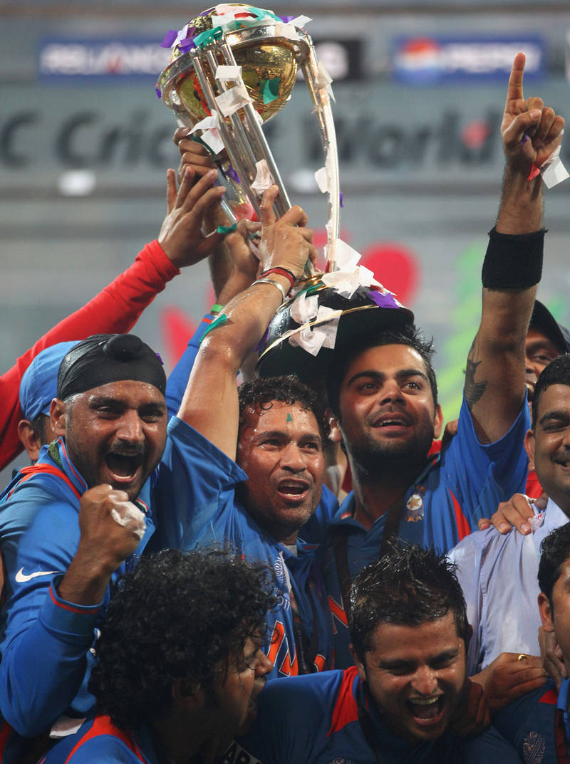
Moral
Classical
Quantum
Vs.
Task: sending arbitrary quantum state
Infinite classical comm
2 bits of classical comm

Slide 39

Is it magic?

Slide 40
Is it magic?
Of course not!

Slide 41
Is it magic?
Ingredient: Quantum Mechanics

Slide 42
Is it magic?
Entangled states

Slide 43
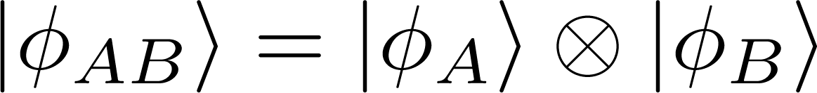
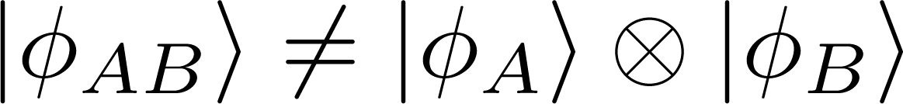
What is entanglement?
Unentangled/Useless states:
Entangled/Useful states:

Slide 44
What is entanglement?
Unentangled/Useless states:
Entangled/Useful states:

Slide 45
What is entanglement?
Unentangled/Useless states:
Entangled/Useful states:

Slide 46
Is it just theory?

Slide 47
Experiments

Slide 48
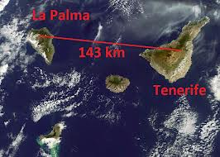
Photons

Slide 49
Photons
143 Km Teleportation
Notes:
Several large telescopes are located at the facilities on the
volcanic mountains of La Palma (left) and Tenerife (right).
This infrastructure on the neighbouring islands enables long-distance
laser links over 143 km, an ideal testing distance for laser links
between the ground and a satellite, where a similar amount of
atmosphere needs to be crossed. This image was acquired on 9 November 2011 by Envisat’s Medium Resolution Imaging Spectrometer (MERIS).
Read more at: http://phys.org/news/2012-09-km-physicists-quantum-teleportation-distance.html#jCp
Several large telescopes are located at the facilities on the
volcanic mountains of La Palma (left) and Tenerife (right).
This infrastructure on the neighbouring islands enables long-distance
laser links over 143 km, an ideal testing distance for laser links
between the ground and a satellite, where a similar amount of
atmosphere needs to be crossed. This image was acquired on 9 November 2011 by Envisat’s Medium Resolution Imaging Spectrometer (MERIS).
Read more at: http://phys.org/news/2012-09-km-physicists-quantum-teleportation-distance.html#jCp

Slide 50


~100KM

Slide 51
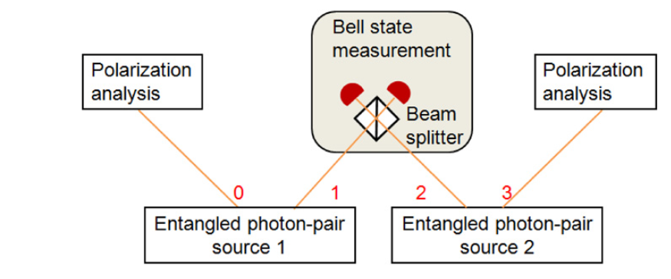
Entanglement Swapping
Zukowski, Zeilinge, Horne, Ekert, PRL 71, 4287 (’93)

Slide 52
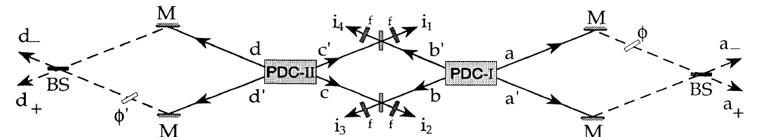
Entanglement Swapping
Zukowski, Zeilinge, Horne, Ekert, PRL 71, 4287 (’93)

Slide 53
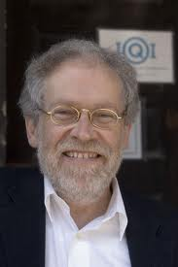
Photons
Photons

Slide 54
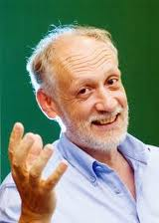
Photons
Photons

Slide 55
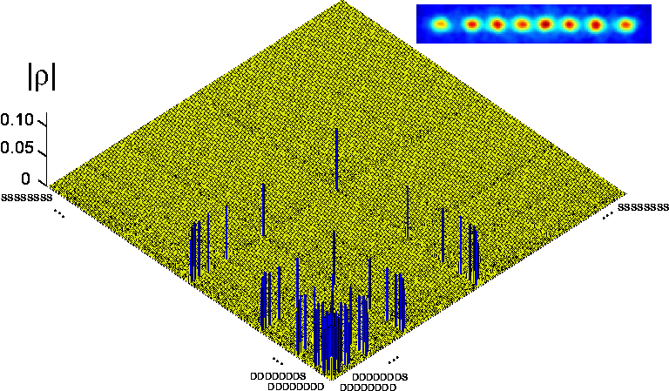
IONS

Slide 56
IONS
14 ions entangled

Slide 57
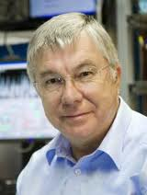
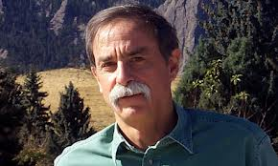
ION Entangled States
Phys. Rep. 2008

Slide 58
Quantum Teleportation
between Light and Matter

Slide 59
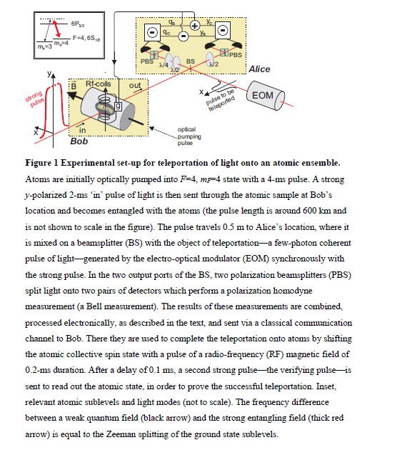
Quantum Teleportation
between Light and Matter

Slide 60
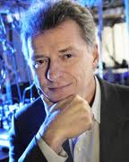
Quantum Teleportation
between Light and Matter
Polzik’s group, Nature 443, 557 (’06)

Slide 61
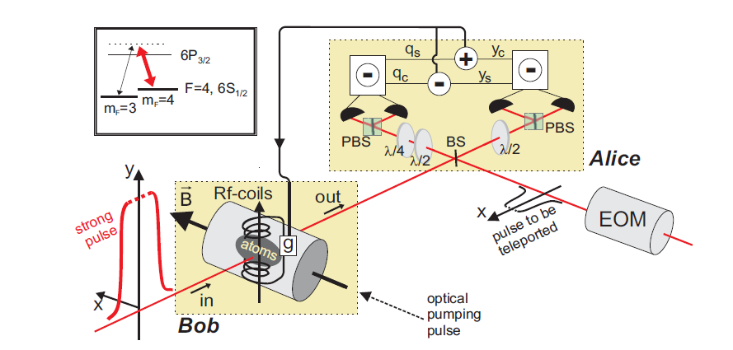
Quantum Teleportation
between Light and Matter
Polzik’s group, Nature 443, 557 (’06)

Slide 62
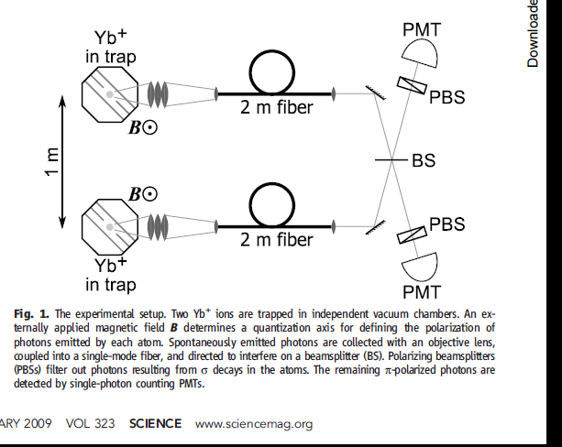
IONS: Teleportation

Slide 63
IONS: Teleportation

Slide 64
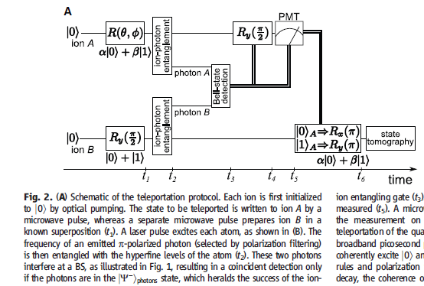
IONS: Teleportation

Slide 65
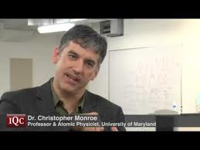

IONS: Teleportation

Slide 66
NMR
Entangled states in NMR

Slide 67
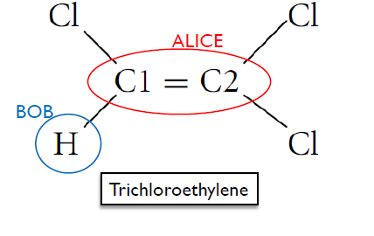
Teleportation by NMR

Slide 68
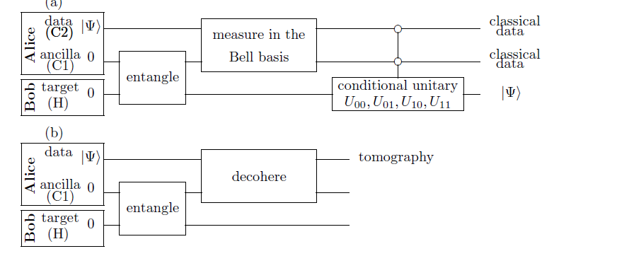
Teleportation by NMR
Nielsen, Knill, Laflamme, Nature 395 (’98)

Slide 69
Optical Lattices

Slide 70
Optical Lattices
Entangled states in
Optical lattices

Slide 71
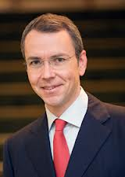
Optical Lattices
Entangled states in
Optical lattices

Slide 72
Optical Lattices
Resonating valence bond states in
Optical lattices

Slide 73
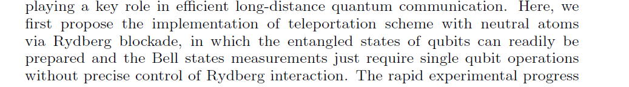
Teleportation: Neutral Atoms
Wu, Yang, Shen, Zheng, J. Phys. B: At. Mol. Opt. Phys. 46,185502 (’13)

Slide 74
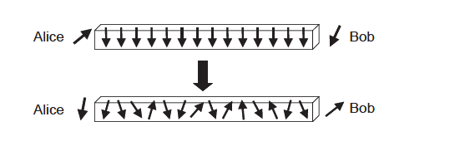
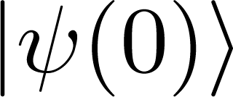
Teleportation: Spin chain
1. Initially the spin chain is in the ground state:

Slide 75
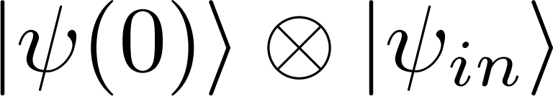
Teleportation: Spin chain
1. Initially the spin chain is in the ground state:
2. Alice places an arbitrary state at her end:

Slide 76
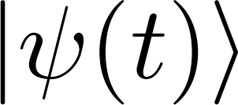
Teleportation: Spin chain
1. Initially the spin chain is in the ground state:
2. Alice places an arbitrary state at her end:
3. The state evolves according to some Hamiltonian:

Slide 77
Teleportation: Spin chain
1. Initially the spin chain is in the ground state:
2. Alice places an arbitrary state at her end:
3. The state evolves according to some Hamiltonian:
4. Bob receives the state after some time.
Bose, PRL(’03), Subrahmanyam, PRA (’03)

Slide 78
Many other systems …….

Slide 79
Teleportation for arbitrary states

Slide 80

A
B
Alice & Bob share a state

Slide 81

A
B
Alice & Bob share a state

Slide 82
C^{d}
in
A
B
Task: To send to Bob
single copy of is available

Slide 83
in
A
B
Allowed operations: LOCC

Slide 84
in
A
B
Not allowed operations: exchange qubits

Slide 85
in
A
B
Alice & Bob perform some LOCC, T,

Slide 86
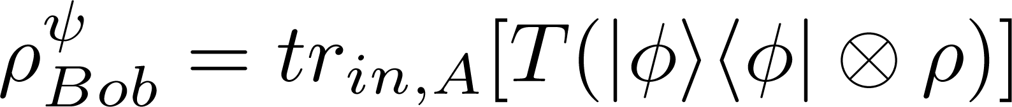
in
A
B
Alice & Bob perform some LOCC, T, and create at Bob’s side

Slide 87
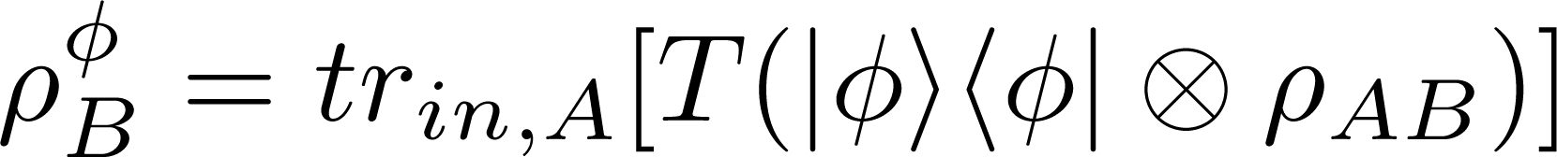
in
A
B
Alice & Bob perform some LOCC, T, and create at Bob’s side
Check its closeness with

Slide 88
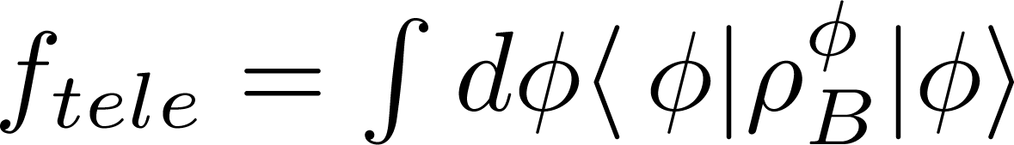
in
A
B
Quantify closeness:
Teleportation fidelity
integration over all inputs

Slide 89

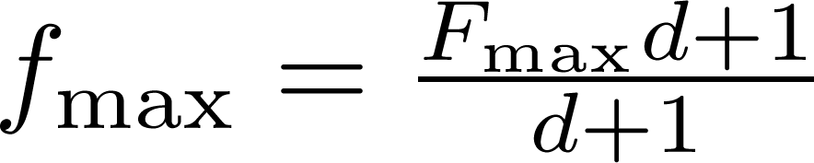
Singlet Fraction:
: max singlet fraction from by LOCC
Bennett, Divincenzo, Smolin, Wootters, PRA 54, 3824 (’97)
MPR Horodeccy, PRA 60, 1888 (’99)
M.A. Nielsen, quant-ph/0205035

Slide 90
Singlet Fraction:
: max singlet fraction from by LOCC
Horodeccy, PRA 60, 1888 (’99)
Nielsen, arXiv: 0205035
Verstreate, Verschele, PRL 90, 097901 (’03)

Slide 91
Alice & Bob share separable state, then f_{max} =2/3
Popescu, PRL 72, 797 (’94)

Slide 92
Tele Capacity:
Known/Unknown
Single Sender – Single Receiver
dd
Solved ☺

Slide 93
Teleportation Network 1

Slide 94

Teleportation: Monogamy
Senders
Receiver
Alice
Charu
Bob
Debu
.
.
.
.
Nitu

Slide 95
Teleportation: Monogamy
Senders
Receiver
Alice
Charu
Bob
Debu
.
.
.
.
Teleportation monogamy
Faithful teleportation cannot be freely performed
Nitu

Slide 96
Teleportation: Monogamy
Tele mono ineq:
Lee and Park, PRA 79, 054309(’09)

Slide 97
Teleportation: Monogamy
Holds for pure states:
Lee and Park, PRA 79, 054309(’09)

Slide 98
Teleportation: Monogamy
Holds for pure states:
Follows from monogamy of concurrence squared in 2d
Lee and Park, PRA 79, 054309(’09)

Slide 99
Teleportation: Monogamy
Does Not hold for mixed states:
Lee and Park, PRA 79, 054309(’09)

Slide 100
Teleportation Network 2

Slide 101
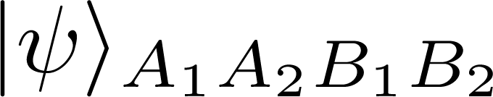
Teleportation Network
Bob (B₁)
Alice (A₁)
Alice (A₂)
Bob (B₂)
ASD, U. Sen, PRA 81, 012308 (’01)

Slide 102
Teleportation Network
Bob (B₁)
Alice (A₁)
Alice (A₂)
Bob (B₂)
ASD, U. Sen, PRA 81, 012308 (’01)

Slide 103
Teleportation Network
Bob (B₁)
Alice (A₁)
Alice (A₂)
Bob (B₂)
Establish relation between capacity & entanglement
ASD, U. Sen, PRA 81, 012308 (’01)

Slide 104
Tele Capacity:
Known/Unknown
Single Sender – Single Receiver
dd
Solved ☺

Slide 105
Tele Capacity:
Known/Unknown
Single Sender – Single Receiver
dd
Solved ☺
Many Senders – single Receiver
Not Solved ☹

Slide 106
Tele Capacity:
Known/Unknown
Single Sender – Single Receiver
dd
Solved ☺
Many Senders – single Receiver
Not Solved ☹
Many Senders – many Receiver
Not Solved ☹

Slide 107
known/Unknown
Classical info transmit
Quantum info transmission
Single Sender – Single Receiver
Many Senders – Single Receiver
Single Sender – Single Receiver
dd
Solved ☺
Solved ☺
Many Senders – Single Receiver
Many Senders – Two Receivers
Partially Solved
Not Solved ☹
Many Senders – Many Receivers
Many Senders – Many Receivers
Not Solved ☹
Not Solved ☹

Slide 108
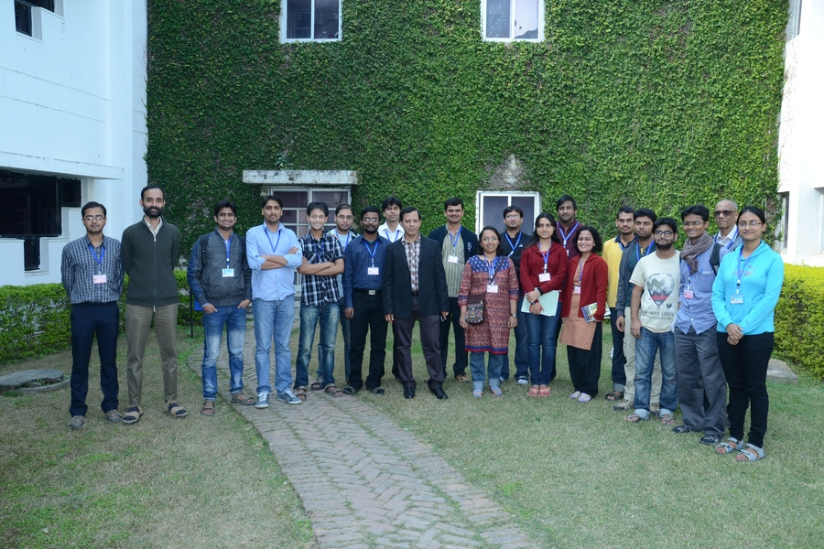
QIC@HRI

Slide 109


