Slide 1

Quantum Communication
Aditi Sen(De)
Harish-Chandra Research Institute, India

Slide 2
Outline
Communication
Communication
Secure Communication
Quantum Cryptography

Slide 3
Outline
Classical info
transmission
Communication
Without security
Quantum state
transmission
Communication
Secure Communication
Quantum Cryptography

Slide 4
Outline
Classical info
transmission
Communication
Without security
Quantum state
transmission
Communication
Secure Communication
Quantum Cryptography

Slide 5
Outline
Classical info
transmission
Communication
Without security
Quantum state
transmission
Communication
Secure Communication
Quantum Cryptography

Slide 6

Communication
Notes:
We r in an age of communication.

Slide 7
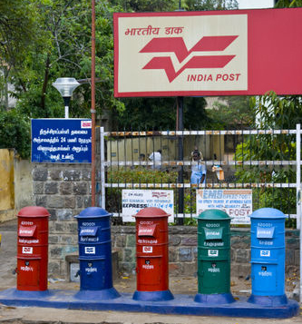
Communication
Notes:
Recently, the telegram was phased out.

Slide 8
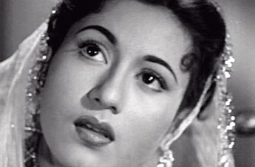
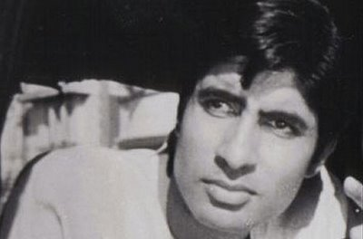
What is Communication?
At least 2 parties
Sender
Receiver
Alice
Bob
Communication is a process by which
information is sent by a sender to a receiver
via some medium.

Slide 9
What is Communication?
At least 2 parties
Sender
Receiver
Alice
Bob
Communication is a process by which
information is sent by a sender to a receiver
via some medium.

Slide 10
What is Communication?
At least 2 parties
Sender
Receiver
Alice
Bob
Communication is a process by which
information is sent by a sender to a receiver
via some medium.

Slide 11
What is Communication?
At least 2 parties
Sender
Receiver
Alice
Bob
Communication is a process by which
information is sent by a sender to a receiver
via some medium.

Slide 12
What is Communication?
At least 2 parties
Sender
Receiver
Alice
Bob
a process by which
information is sent by a sender to a receiver
via some medium.

Slide 13
What is Communication?
encodes
Alice (Encoder)
Sends
Bob (Decoder) receives & decodes

Slide 14
What is Communication?
“Information is physical”
---Landauer
information must be encoded in, and decoded from a physical system.
encoding/Decoding
red-green balls,
sign of charge of a particle.
Classical World
Only orthogonal states
Quantum World: Nonorthogonal states

Slide 15
What is Communication?
“Information is physical”
---Landauer
information must be encoded in, and decoded from a physical system.
encoding/Decoding
red-green balls,
sign of charge of a particle.
Classical World
Only orthogonal states
Quantum World: Nonorthogonal states

Slide 16
What is Communication?
“Information is physical”
---Landauer
information must be encoded in, and decoded from a physical system.
encoding/decoding
red-green balls,
sign of charge of a particle.
Classical World
Only orthogonal states
Quantum World: Nonorthogonal states

Slide 17
What is Communication?
“Information is physical”
---Landauer
information must be encoded in, and decoded from a physical system.
encoding/decoding
red-green balls,
sign of charge of a particle.
Classical World
Only orthogonal states
Quantum World: Nonorthogonal states

Slide 18
What is Communication?
“Information is physical”
---Landauer
information must be encoded in, and decoded from a physical system.
encoding/decoding
red-green balls,
sign of charge of a particle.
Do quantum states advantageous?
Classical World
Only orthogonal states
Quantum World: Nonorthogonal states

Slide 19
Classical Information Transmission
via Quantum States
Part 1

Slide 20

Quantum Dense Coding
Bennett & Wiesner, PRL 1992
Notes:
Unfortunately, I could not find a picture of Wiesner.

Slide 21
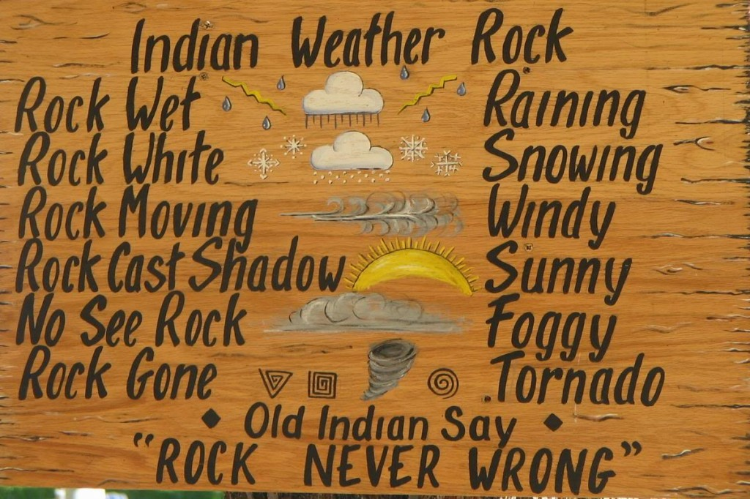

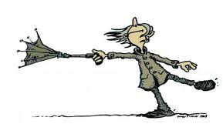

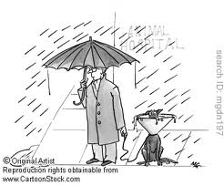
Classical Protocol
Sunny
Windy
Snowing
Raining
Notes:
Here, “Indian” could be native Americans.

Slide 22

Classical Protocol
Sunny
Windy
Snowing
Raining

Slide 23
Classical Protocol
Sunny
Windy

Slide 24
Classical Protocol
Sunny
Windy
Snowing
Raining

Slide 25
Classical Protocol
Sunny
Windy
Snowing
Raining

Slide 26
Classical Protocol
Sunny
2 bits
Windy
Snowing
Raining

Slide 27
Classical Protocol
Sunny
2 bits
Windy
Classical computer unit:
Bit = one of {0, 1}
Snowing
Raining

Slide 28
Classical Protocol
Alice
Bob
Message
Encoding
Decoding
Sunny
00
Sending
Snowing
01
Distinguishable
by color
Windy
10
Raining
11

Slide 29
Classical Protocol
Alice
Bob
Message
Encoding
Decoding
Sunny
2 bits 4 dimension
Snowing
Distinguishable
by color
Windy
Raining

Slide 30
What abt Quantum?

Slide 31
Quantum Protocol
Alice
Bob
Message
Sunny
A
B
Snowing
Windy
Singlet state
Raining

Slide 32



Bob
Alice
U
B
A
Message
Alice performs unitary on her particle
Sunny
I
Snowing
Windy
Raining

Slide 33
Bob
Alice
U
B
A
Message
Alice performs unitary on her particle
Sunny
I
Snowing
Creates 4 orthogonal states
Singlet, Triplets
Windy
Raining

Slide 34
Bob
Alice
U
B
A
Message
Sunny
I
Alice sends her particle to Bob
Snowing
Windy
Raining

Slide 35
Bob
Alice
B
A
Message
Sunny
I
Bob has 2 particles:
one of the triplets or singlet
Snowing
Windy
Raining

Slide 36
A
B
Alice
Bob
Decoding
Message
Sunny
I
Snowing
4 orthogonal states
Possible to distinguish
Windy
Raining

Slide 37
A
B
Alice
Bob
Decoding
Message
Sunny
I
Snowing
4 orthogonal states
Possible to distinguish
Windy
Decodes message
Raining

Slide 38
A
B
Alice
Bob
Decoding
Message
Sunny
I
2 bits 2 dimension
Snowing
4 orthogonal states
Possible to distinguish
Windy
Raining

Slide 39
Moral
Classical
Quantum
Vs.
Task: sending 2 bits
Encoding: 4 Dimensions
Encoding: 2 Dimensions

Slide 40
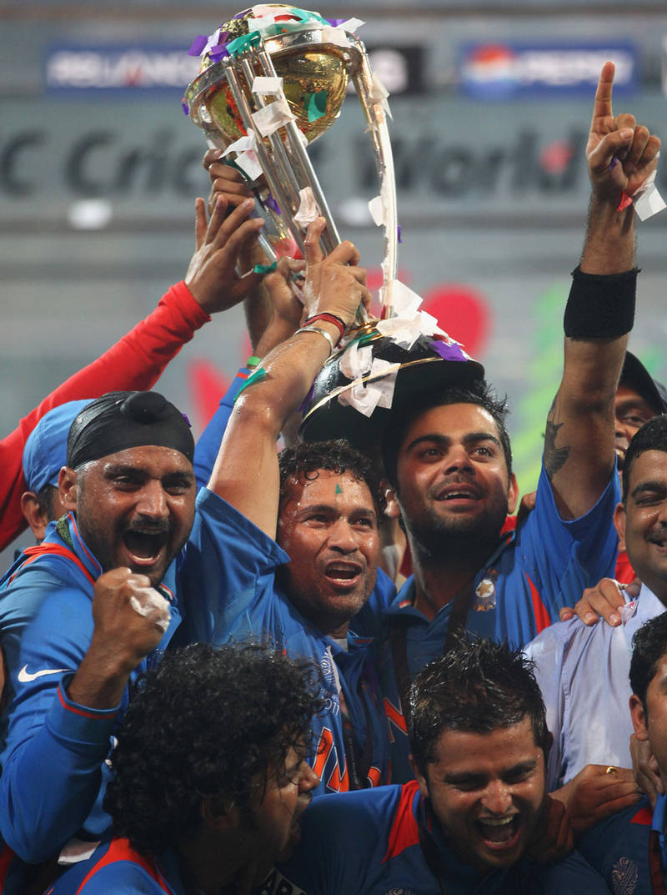
Moral
Classical
Quantum
Vs.
Task: sending 2 bits
Encoding: 4 Dimensions
Encoding: 2 Dimensions
Bennett & Weisner, PRL 69, 2881 (’92).

Slide 41
Dense Coding for arbitrary state
Hiroshima, J. Phys. A ’01;
Ziman & Buzek, PRA ’03,
Bruss, D’Ariano, Lewenstein, Macchiavello, ASD, Sen, PRL’ 04

Slide 42

A
B
Alice & Bob share a state

Slide 43
Encoding
A
B
Alice’s aim:
to send classical info i

Slide 44
Encoding
A
B
Alice’s aim:
to send classical info i
which occurs with probability p_{i}

Slide 45
Encoding
U_{i}
A
B
Alice performs p_{i} , U_{i}

Slide 46
Encoding
U_{i}
A
B
Alice performs p_{i} , U_{i}
she produces the ensemble E = {p_{i}, ρ_{i}}

Slide 47
Encoding
U_{i}
A
B
Alice performs p_{i} , U_{i}
she produces the ensemble E = {p_{i}, ρ_{i}}

Slide 48
Sending
U_{i}
A
B
Alice performs p_{i} , U_{i}
she produces the ensemble E = {p_{i}, ρ_{i}}
Alice sends her particle to Bob

Slide 49
Decoding
A
B
Alice
Bob

Slide 50
Decoding
A
B
Alice
Bob’s task:
Gather info abt i

Slide 51
Decoding
A
B
Alice
Bob’s task:
Gather info abt i
Bob measures and obtains outcome j with prob q_{j}

Slide 52
Decoding
A
B
Alice
Bob’s task:
Gather info abt i
Post measurement ensemble: E|j= {p_{i|j}, _{i|j}}

Slide 53
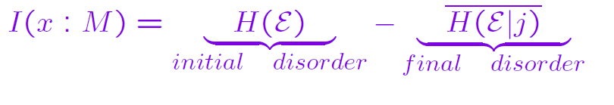
Decoding
Mutual information:
i
A
B
Alice
Bob’s task:
Gather info abt i
Post measurement ensemble: E|j= {p_{i|j}, _{i|j}}

Slide 54
Decoding
Mutual information:
i
A
B
I_{acc} = max I(i:M)
Alice
Bob’s task:
Gather info abt i

Slide 55
Decoding
A
B
Alice
Bob’s task:
Gather info abt i
I_{acc} = max I (i:M)
= Maximal classical information
from E= {p_{i}, ρ_{i}}.

Slide 56
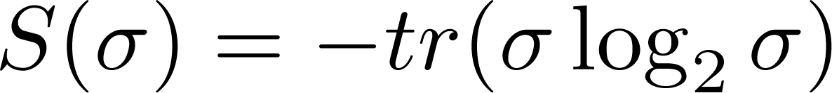
Holevo Theorem 1973
Initial ensemble E = {p_{i}, ρ_{i}}

Slide 57
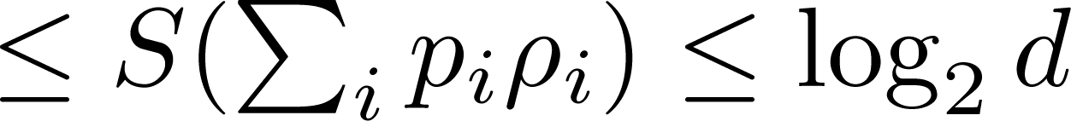
Holevo Theorem 1973
Initial ensemble E = {p_{i}, ρ_{i}}

Slide 58
Holevo Theorem 1973
Initial ensemble E = {p_{i}, ρ_{i}}
d: dimension of ρ_{i}

Slide 59
Holevo Theorem 1973
Initial ensemble E = {p_{i}, ρ_{i}}
Bit per qubit

Slide 60
Decoding
A
B
Alice
Bob’s task:
Gather info abt i
Accessible information
= Maximal classical information
from E = {p_{i}, ρ_{i}}.

Slide 61
DC Capacity
Dense coding capacity:
maximization over all encodings
i.e. over all {p_{i,} U_{i} }
C = Max I_{acc}

Slide 62
DC Capacity
Dense coding capacity:
maximization over all encodings
i.e. over all {p_{i,} U_{i} }
C = Max I_{acc}
= Max Holevo quantity
obtained by Bob

Slide 63
DC Capacity
Dense coding capacity:
maximization over all encodings
i.e. over all {p_{i,} U_{i} }
Holevo can be achieved asymptotically
C = Max I_{acc}
= Max Holevo quantity
obtained by Bob
Schumacher, Westmoreland, PRA 56, 131 (’97)

Slide 64
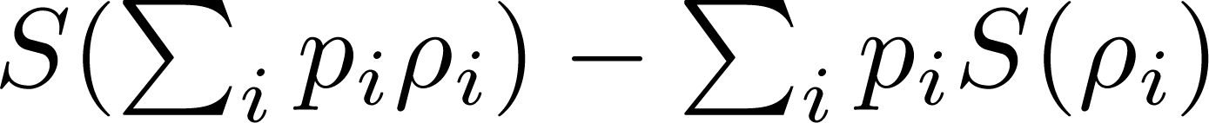
DC Capacity
Dense coding capacity:
maximization over all encodings
i.e. over all {p_{i,} U_{i} }
C = Max I_{acc}
= Max

Slide 65
DC Capacity
Dense coding capacity:
maximization over all encodings
i.e. over all {p_{i,} U_{i} }
C = Max I_{acc}
= Max

Slide 66
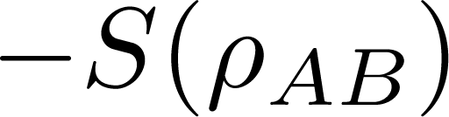
DC Capacity
C = Max

Slide 67

DC Capacity
C = Max

Slide 68
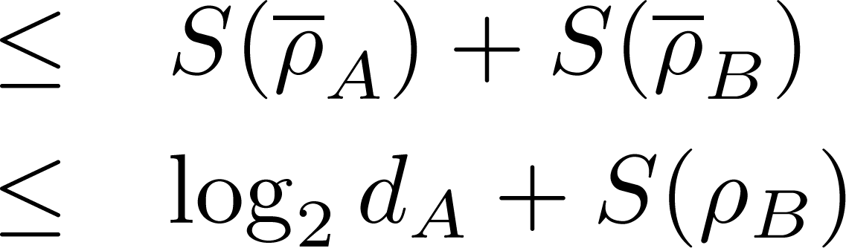
DC Capacity
C = Max

Slide 69
DC Capacity
C = log₂ d_{A} + S(ρ_{B}) - S(ρ_{AB})

Slide 70
DC Capacity
C = log₂ d_{A} + S(ρ_{B}) - S(ρ_{AB})
A state is dense codeable
I_{B =} S(ρ_{B}) - S(ρ_{AB}) > 0

Slide 71
Classification of states
Entangled
S
DC
In 22, 23

Slide 72
DC Capacity:
Known/Unknown
Single Sender – Single Receiver
Solved ☺

Slide 73
Dense Coding
Network

Slide 74
Why quantum dense coding network?
Point to point communication has limited commercial use

Slide 75
Why quantum dense coding network?
To build a quantum computer,
or communication network

Slide 76
Why quantum dense coding network?
To build a quantum computer,
or communication network,
classical info transmission

Slide 77
Why quantum dense coding network?
To build a quantum computer,
or communication network,
classical info transmission
via quantum state in network

Slide 78
Dense Coding Network 1

Slide 79

Dense Coding Network
Receivers
Sender
Bob
Charu
Alice
Debu
.
.
.
.
Nitu

Slide 80
Dense Coding Network
Receivers
Sender
Bob
Charu
Alice
Debu
.
.
.
.
Task: Alice individually sends
classical info to all the receivers
Nitu

Slide 81
Dense Coding Network
Receivers
Sender
Bob
Charu
Alice
Debu
.
.
.
.
Nitu
R. Prabhu, A. K. Pati, ASD, U. Sen, PRA ’ 2013
R. Prabhu, ASD, U. Sen, PRA’ 2013
R. Nepal, R. Prabhu, ASD, U. Sen, PRA’ 2013

Slide 82
Dense Coding Network
Receivers
Sender
Bob
Ujjwal’s Talk
Prabhu’s Talk
Charu
Alice
Debu
.
.
.
.
Nitu
R. Prabhu, A. K. Pati, ASD, U. Sen, PRA ’ 2013
R. Prabhu, ASD, U. Sen, PRA’ 2013
R. Nepal, R. Prabhu, ASD, U. Sen, PRA’ 2013

Slide 83
Dense Coding Network 2

Slide 84

Dense Coding Network
Senders
Receiver
Alice
Charu
Bob
Debu
.
.
.
.
Nitu

Slide 85
Dense Coding Network
Senders
Receiver
Alice
Charu
Bob
Debu
.
.
.
.
Several senders & a single receiver
Nitu

Slide 86
Dense Coding Network
Senders
Receiver
Alice
Charu
Bob
Debu
.
.
.
.
Several senders & a single receiver
Task:
All senders send classical info {i_{k}, k=1,2, ..N}
to a receiver
Nitu

Slide 87
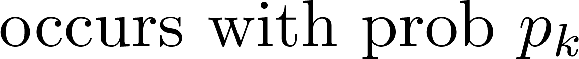
Dense Coding Network
Senders
Receiver
Alice
Charu
Bob
Debu
.
.
.
.
Task:
All senders send classical info {i_{k}, k=1,2, ..N}
to a receiver
Nitu

Slide 88
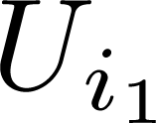
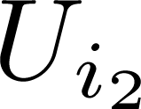
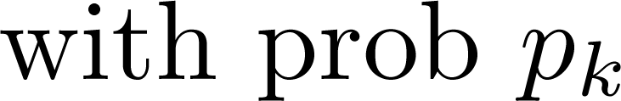
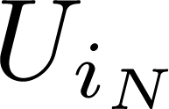
Dense Coding Network
Senders
Receiver
Alice
Charu
Bob
Debu
.
.
.
.
Nitu
senders perform U_{ik}, k=1,2, ..N on her parts

Slide 89
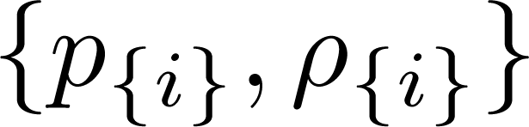
Dense Coding Network
Senders
Receiver
Alice
Charu
Bob
Debu
.
.
.
.
Senders create ensemble
Nitu

Slide 90
Dense Coding Network
Senders
Receiver
Alice
Charu
Bob
Debu
.
.
.
.
Senders create ensemble
Nitu

Slide 91
Dense Coding Network
Senders
Receiver
Alice
Charu
Bob
Debu
.
.
.
.
Senders send ensemble to Bob
Nitu

Slide 92
Dense Coding Network
Senders
Receiver
Alice
Charu
Bob
Debu
.
.
.
.
Nitu
Bob’s task: gather info abt

Slide 93
DC Capacity network
DC capacity network
maximization over all encodings
i.e. over all {p_{{i},} U_{{i}} }
C = Max I_{acc}
= Max Holevo quantity
obtained by Bob

Slide 94
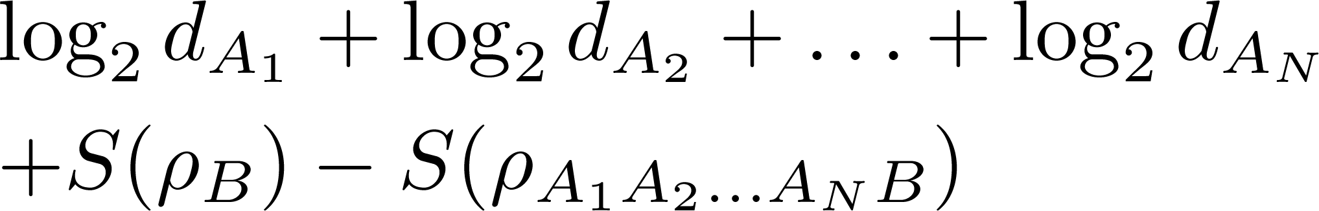
DC Capacity Network
C =
Bruss, D’Ariano, Lewenstein, Macchiavello, ASD, Sen, PRL’ 04
Bruss, Lewenstein, ASD, Sen, D’Ariano, Macchiavello, Int. J. Quant. Info. ’05

Slide 95
DC Capacity Network
C =
Tamoghna’s Poster
Bruss, D’Ariano, Lewenstein, Macchiavello, ASD, Sen, PRL’ 04
Bruss, Lewenstein, ASD, Sen, D’Ariano, Macchiavello, Int. J. Quant. Info. ’05

Slide 96
DC Capacity:
Known/Unknown
Single Sender – Single Receiver
Many Senders – Single Receiver
Solved ☺

Slide 97
Dense Coding Network 3

Slide 98

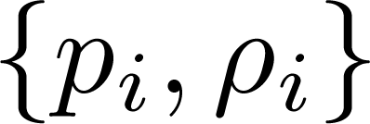
Distributed DC: Two receivers
Bob (B₁)
Alice (A₁)
Alice (A₂)
Bob (B₂)

Slide 99
Distributed DC: Two receivers
Bob (B₁)
i₁
Alice (A₁)
LOCC
i₂
Alice (A₂)
Bob (B₂)

Slide 100
Distributed DC: Two receivers
Bob (B₁)
Alice (A₁)
Alice (A₂)
Bob (B₂)

Slide 101
Distributed DC: Two receivers
Bob (B₁)
Alice (A₁)
Alice (A₂)
Bob (B₂)
Alices send her particles to Bobs

Slide 102
Distributed DC: Two receivers
Bob (B₁)
Bob (B₂)
Bobs task: gather info abt i_{k} by LOCC

Slide 103
Distributed DC: Two receivers
Bob (B₁)
LOCC
Bob (B₂)
Bobs task: gather info abt i_{k} by LOCC

Slide 104

Distributed DC: Two receivers
C = Max

Slide 105

Distributed DC: Two receivers
C = Max
Max
LOCC Holevo bound
Maximization over all encodings i.e. over all {p_{i,} U_{i} }

Slide 106
Distributed DC: Two receivers
C = Max
Max
LOCC Holevo bound
Maximization over all encodings i.e. over all {p_{i,} U_{i} }
Badziag, Horodecki, ASD, Sen, PRL’03

Slide 107
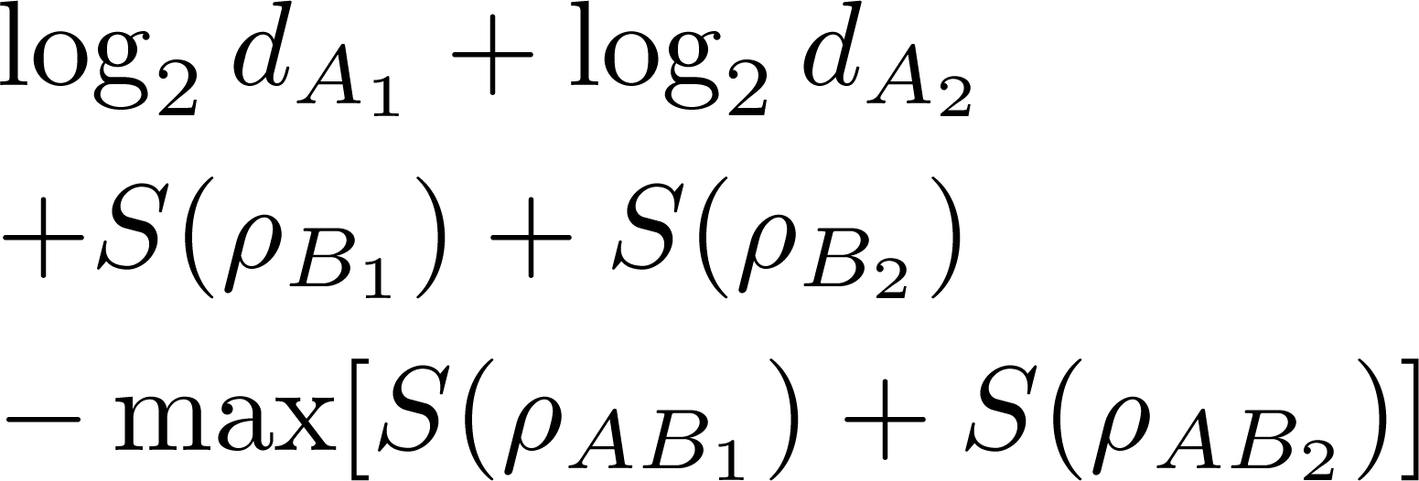
Distributed DC: Two receivers
Bruss, D’Ariano, Lewenstein, Macchiavello, ASD, Sen, PRL’ 04
C = Max
Max
LOCC Holevo bound
Maximization over all encodings i.e. over all {p_{i,} U_{i} }

Slide 108
DC Capacity:
Known/Unknown
Single Sender – Single Receiver
Many Senders – Single Receiver
Solved ☺

Slide 109
DC Capacity:
Known/Unknown
Single Sender – Single Receiver
Many Senders – Single Receiver
Solved ☺
Many Senders – Two Receivers

Slide 110
DC Capacity:
Known/Unknown
Single Sender – Single Receiver
Many Senders – Single Receiver
Solved ☺
Many Senders – Two Receivers
Partially Solved

Slide 111
DC Capacity:
Known/Unknown
Single Sender – Single Receiver
Many Senders – Single Receiver
Solved ☺
Many Senders – Two Receivers
Partially Solved
Many Senders – Many Receivers
Not Solved ☹

Slide 112


