Slide 1
Decoherence-free/Noiseless Subsystems for
Quantum Computation
Mark Byrd
Physics Department, CS Department
Southern Illinois University
Carbondale, Illinois 62901
IPQI, Bhubaneswar February 24, 2014
Outline:
Background
Some examples
Quantum computing on a DFS
Three-qubit DFS for quantum dots
Summary
For introductory material: QUNET WIKIBOOK: http://qunet.physics.siu.edu/wiki

Slide 2
Noisy Quantum Systems
Decoherence-free subspaces (DFS) were invented to avoid noise. (They have primarily been used for noise that is collective, but in principle, they could be used as long as an appropriate symmetry exists.)
D.A. Lidar, I.L. Chuang and K.B. Whaley, Phys. Rev.Lett. 81, 2594 (1998). Knill, et al. Phys. Rev. Lett. 84, 2525 (2000). Kempe, et al. Phys.Rev. A 63, 042307 (2001).
Dicke States – a collection of particles in a particular state of total angular momentum. Dicke, Phys. Rev. 93, 99 (1954)
If two parties don’t share a reference frame, rotationally invariant states are required to communicate. Bartlett et al., Rev. Mod. Phys. 79, 555 (2007)
If we encode in a DFS, universal quantum computing can be performed on a subspace even though it is not possible on the whole Hilbert space.
Kempe, et al. PRA (2001)

Slide 3






Decoherence-Free/Noiseless Subsystems
Given our general form for the Hamiltonian
where
We may also use the operator-sum representation
Decoherence-free Subsystems: These are subsystems of the Hilbert space which are invariant under some particular set of error operations.
In general, we examine the error algebra generated by the
This algebra is reducible and we want to find the irreducible components. These define the invariant subsystems.
Knill/Lalfamme/Viola,PRL:00
where the n_{J}-fold degenerate d_{J} X d_{J} complex matrices correspond to the irreducible components of . We label these components by J, which collectively form the finite set . (It is important to note that this J actually stands for a set of quantum numbers when the constituents are qudits, with d >2.)
In the case that the subsystem is one-dimensional, we call this a DF subspace.

Slide 4
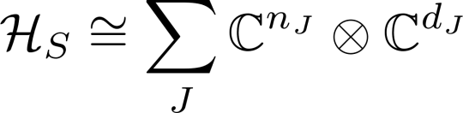
DFS/NS
To the decomposition of the algebra, there is a corresponding decomposition of the Hilbert space
where the second factor corresponds to the part of the Hilbert space which is affected by noise and the first factor corresponds to that part which is not.
Note that algebraic representation theory is directly related to group representation theory by “Weyl’s Unitary Trick”. This states that the irreducible representations of the algebra are directly related to irreducible representations of the group. To see this, note that
Byrd, Phys. Rev. A 73, 032330 (2006)

Slide 5



Two-Qubit DFS
Consider the following (collective) phase-protected DFS:
Levy, Phys. Rev. Lett. 89, 147902 (2002).
Lidar, Wu, Phys. Rev. Lett. 88, 017905
(2002)
For quantum dots
Single qubit logic gates, formed from the Heisenberg exchange interaction, correspond to:
1
2
3
4
5
6
Two qubit gates are achieved using

Slide 6
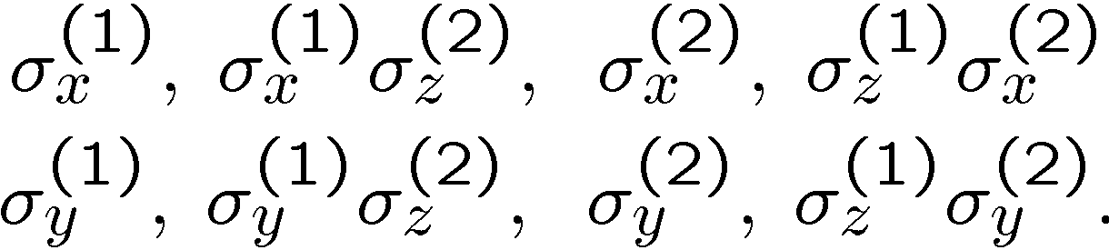
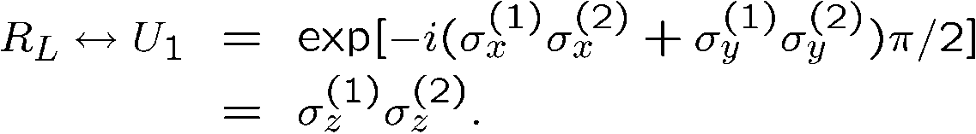

Two-Qubit Decoupling
All leakage errors are one of the following forms:
For example, |01>, |10> in C, |00>, |11> in C . σ_{x}⁽¹⁾, acting on the basis state |01> will produce leakage
To produce a Leakage Elimination Operator, we act with the unitary:
The LEO uses the exchange interaction, acting as a logical X operation:
Byrd and D. A. Lidar, Phys. Rev. Lett. 89, 047901 (2002).

Slide 7


Four-Qubit DFS
For collective errors which include bit-flip, phase-flip, and/or both, i.e. X,Y, Z errors, we can use a four qubit DFS.
When the angular momenta of four qubits is added, the total angular momenta possible are , 0, 1 and 3/2.
There are two singlets, J=0 states. One can be used as a logical zero state and the other as a logical one state .
These are rotationally invariant, so do not change under collective rotations.
This is the smallest decoherence-free subspace.
Lidar, Chuang and Whaley, Phys. Rev. Lett. 81, 2594 (1998)

Slide 8
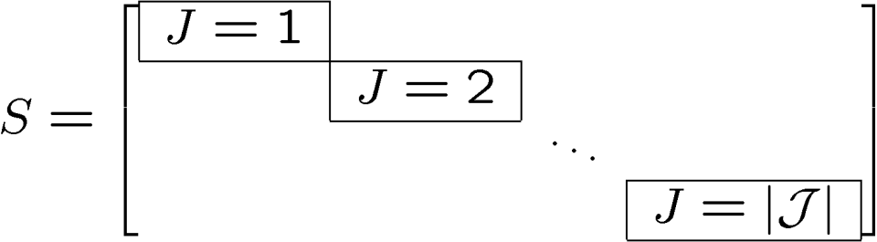
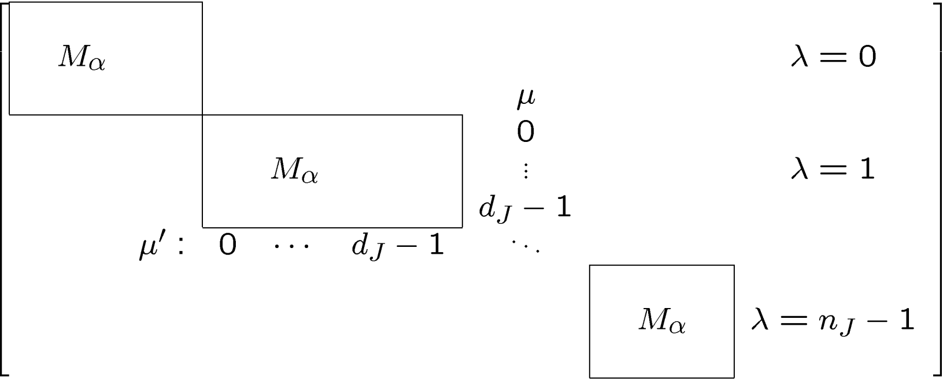
Noiseless Subsystems
For a given J
where λ labels the sub-blocks and μ labels the states within these sub-blocks.

Slide 9
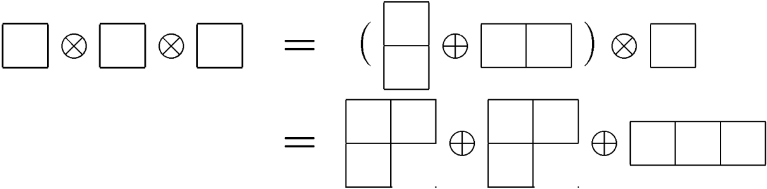
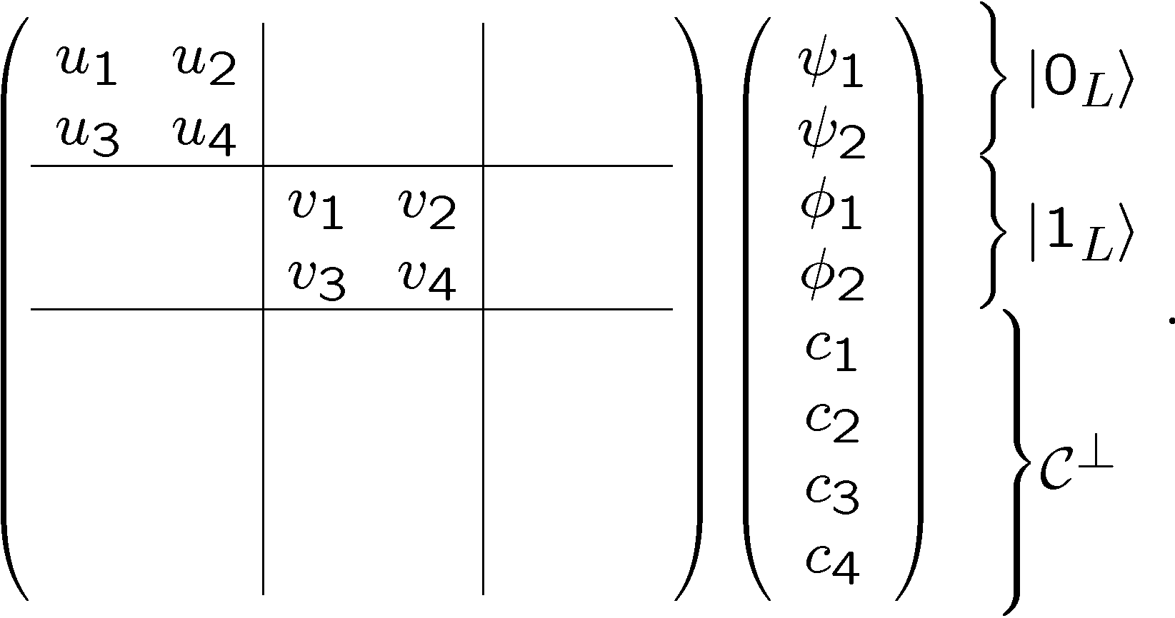
Noiseless Subsystems
To form a noiseless subsystem from 3 qubits, we first look at the irreducible group representations of 3 qubits.
Using Young Tableaux,
In matrix form
Also works for qudits! Byrd, Phys. Rev. A 73, 032330 (2006)

Slide 10
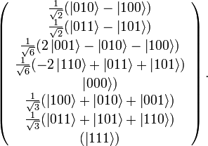

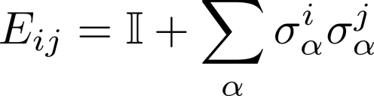
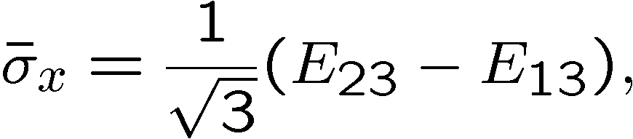
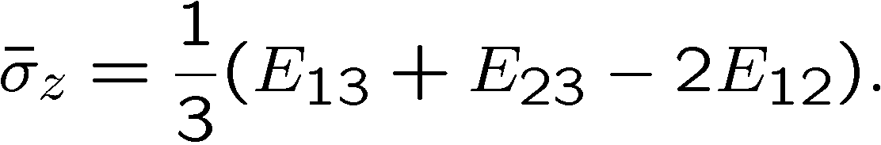
Three-Qubit NS (cont.)
Explicitly:
To perform quantum computing on this DFS, you can use the Heisenberg
exchange interaction:

Slide 11
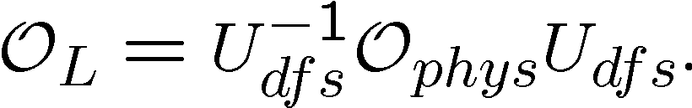
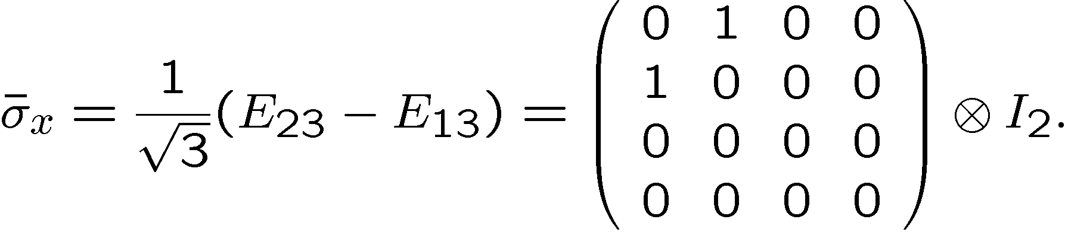
Logical vs. Physical
We can switch between pictures with a change of basis:
Using the logical operations introduced above, we can construct an LEO from interactions involving Heisenberg exchange:
or
The experimentalists doing quantum dot quantum computing call these
“triple dots”.
1
2
3

Slide 12
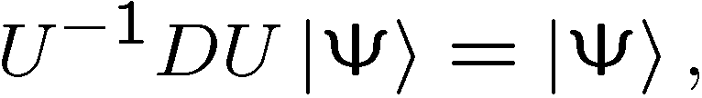

Quantum Computing on a DFS
Any logical operation will take code words to code words.
So let U be such an operation. Then
or
so that
Kempe, et al. Phys.Rev. A 63, 042307 (2001).
This provides a sufficient condition for the a Hamiltonian to be compatible with a NS/DFS:
This also gives us another way in which to design codes. Encode against errors which are correctable up to a stabilizer element.
Byrd/Lidar Phys. Rev. A 67, 012324 (2003) Dave Bacon Phys. Rev. A 73, 012340 – Published 29 January 2006 Kribs, et al. Phys. Rev. Lett. 94, 180501 (2005).

Slide 13






There is an Algorithm
Let us begin with notation. is the Hamiltonian. is a complete set of Hermitian matrices in
terms of which any Hermitian matrix can be expanded. The form a basis for the stabilizer of
the system, and is an arbitrary linear combination of those stabilizer elements. is a
set of real numbers.
Expand in terms of the complete set of Hermitian matrices described above: .
Determine the commutator of the general Hamiltonian and a generic collective error
where the are arbitrary coefficients. In other words, calculate
Find the projection of onto a component by taking the trace of the basis element
with the result of (2). In other words, calculate for each
Set all of the projections equal to zero and then solve the system of linear equations for the
expansion coefficients which satisfy these relations, thereby determining the which will
commute with
Bishop/Byrd, J. Phys. A: Math. Theor. 42, 055301 (2009)

Slide 14



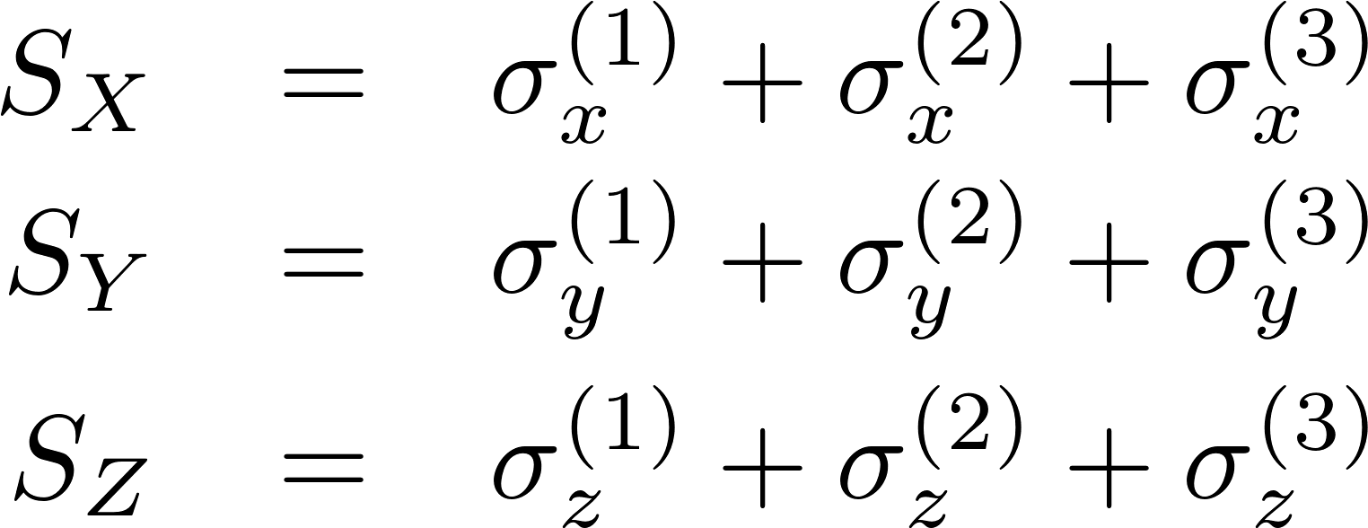
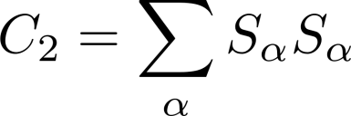
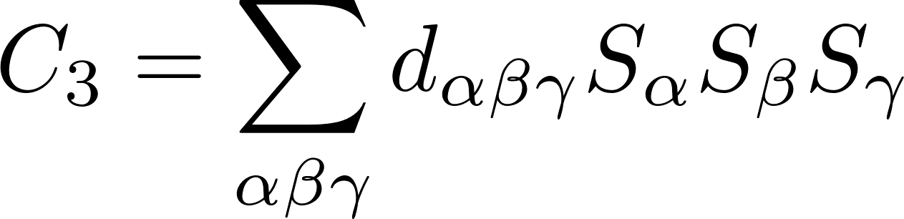
For Collective Errors There is an Analytic Method
The Casimir operators will commute with any element of the algebra:
The collective errors also form a
representation of the algebra:
We then construct the Casimir invariants for the collective errors
Gruber/O’Raifeartaigh:64
Bihsop, et al Phys. Rev. A 83, 062327 (2011)

Slide 15
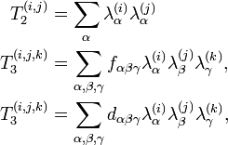
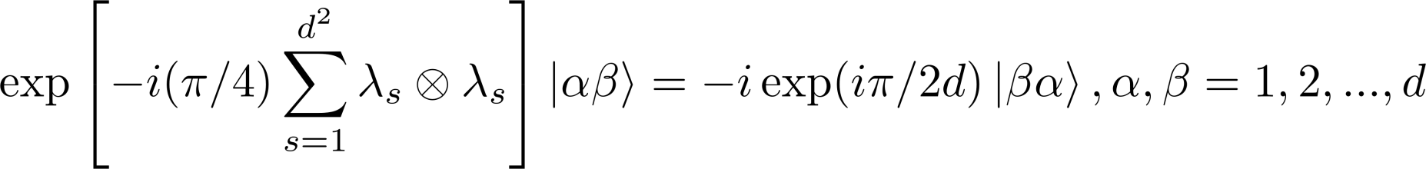
Compatible Transformations
From these, we extract the single particle Casimir invariants and, using the fact that the sum of invariants is and invariant, we get
Bishop/Byrd/Wu:10
The quadratic can be analytically exponentiated to obtain the generalized SWAP for
qudits:
Bishop/Byrd, J. Phys. A: Math. Theor. 42, 055301 (2009)

Slide 16
Finding Collective Errors (or nearly)
To take advantage of a DFS for noise protection, a symmetry must exist in the system-bath interaction. However, such a symmetry may be hard to identify.
Two Algorithms:
Optimize, with respect to the given errors, the effect of errors on a two-state system.
Calculate the commutators to find a the blocks in the block-diagonalization of the errors.
These are symmetry-finding algorithms based on algebraic representation theory. The second will find the largest symmetry.
or
The first will find an approximate symmetry.
Wang, et al. Phys. Rev. A 87, 012338 (2013), arXiv:1305.1978

Slide 17
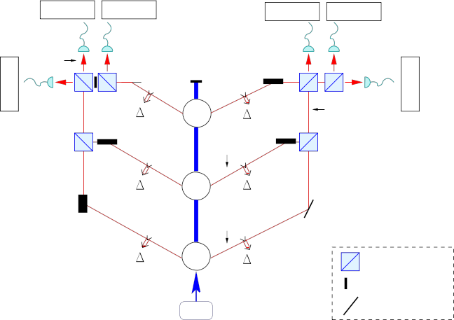
Logical qutrit DFS state from photons
PDC
PDC
PDC
Polarizing
beam-splitter
Photon trap
Mirror
pump
Bishop/Byrd: Phys Rev A 77, 012314 (2008)

Slide 18
Maximally entangled two-qutrit state
PDC
PDC
Pump
Bishop/Byrd: Phys Rev A 77, 012314 (2008)

Slide 19
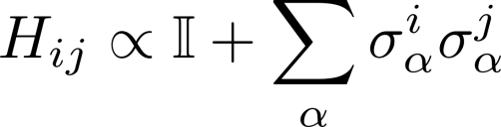
Three-Qubit NS
To perform quantum computing on this DFS, you can use the Heisenberg
exchange interaction:
1
2
3

Slide 20
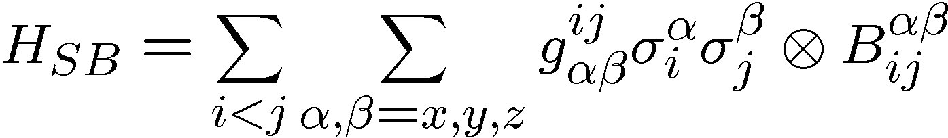
General Errors on Quantum Dots
Consider a bilinear coupling of the form
This can be divided up into terms which are present in solid-state qubit systems due
to spin-orbit coupling errors
Kavokin:Phys. Rev. B 64, 075305 (2001)
If we assume the presence of these types of errors, we may ask the following questions:
Which LEOs are required to remove errors of these types?
Are LEOs the best method? If not, how else should be prevent the errors?

Slide 21
Summary of Results
For the three-qubit DFS/NS, one LEO is not enough.
To eliminate all errors:
Use more decoupling pulses
Choose a material with greater symmetry and eliminate Dzyaloshinski-Moriya (DM) type of error (antisymmetric term)
Use a combination of DFS and a three-qubit QECC
For the four-qubit DFS/NS, one LEO is not enough.
To eliminate all errors:
Use more decoupling pulses
Use a combination of DFS and a three-qubit QECC
The asymmetric DM (Dzyaloshinski-Moriya) term does not induce errors in the 4-q code.
Byrd/Lidar/Wu/Zanardi Phys. Rev. A 71, 052301 (2005)

Slide 22
Summary
Decoherence-free subspaces and noiseless subsystems have some practical value.
New work shows how to compute and use DFS qudits for quantum information processing.
The symmetry-finding algorithm could be very useful.

Slide 23


THE END
Thank you

