Slide 1
COLLIDERS
FUTURE
Sreerup Raychaudhuri
TIFR, Mumbai
International Meeting on High Energy Physics Institute of Physics, Bhubaneswar
January 19, 2019

Slide 2
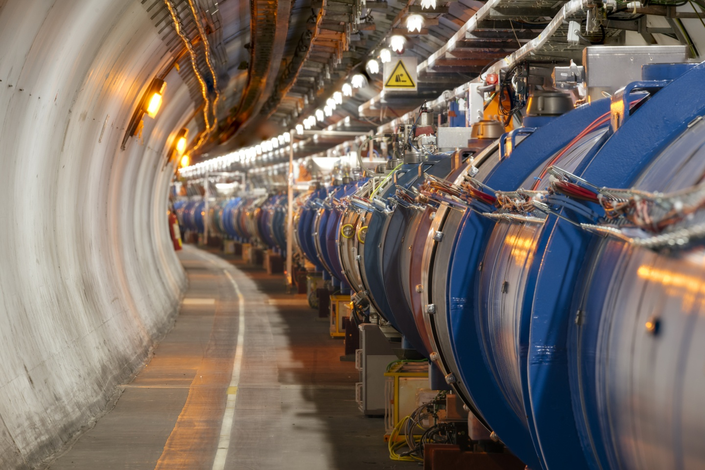
LARGE HADRON COLLIDER
STANDARDMODEL
COLLIDER

Slide 3
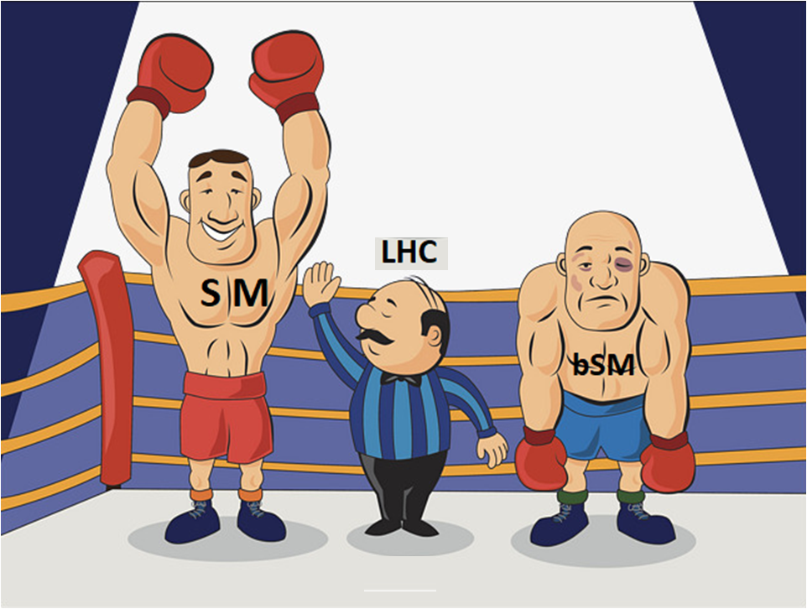
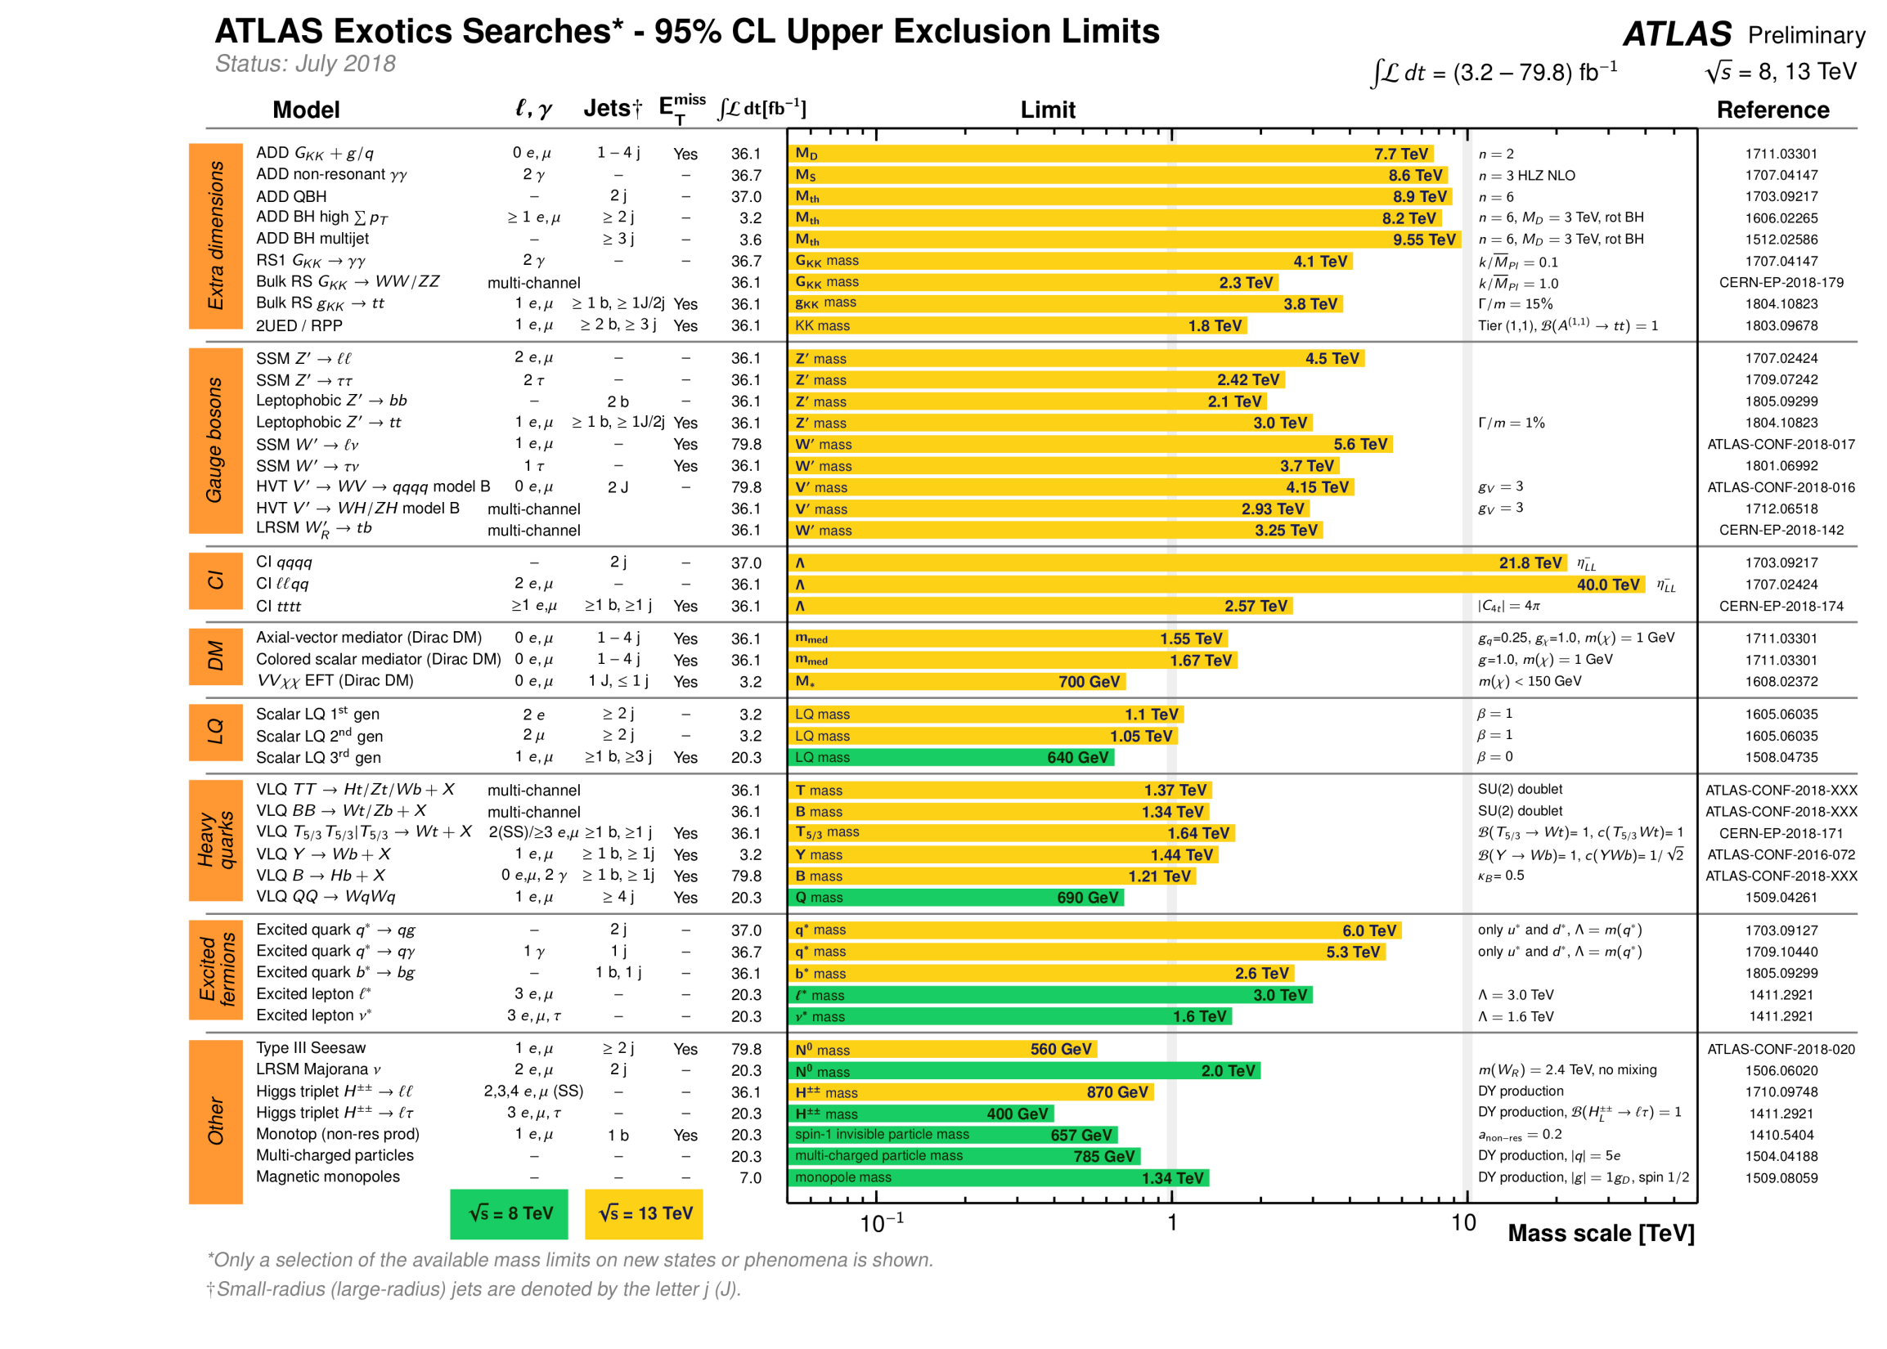
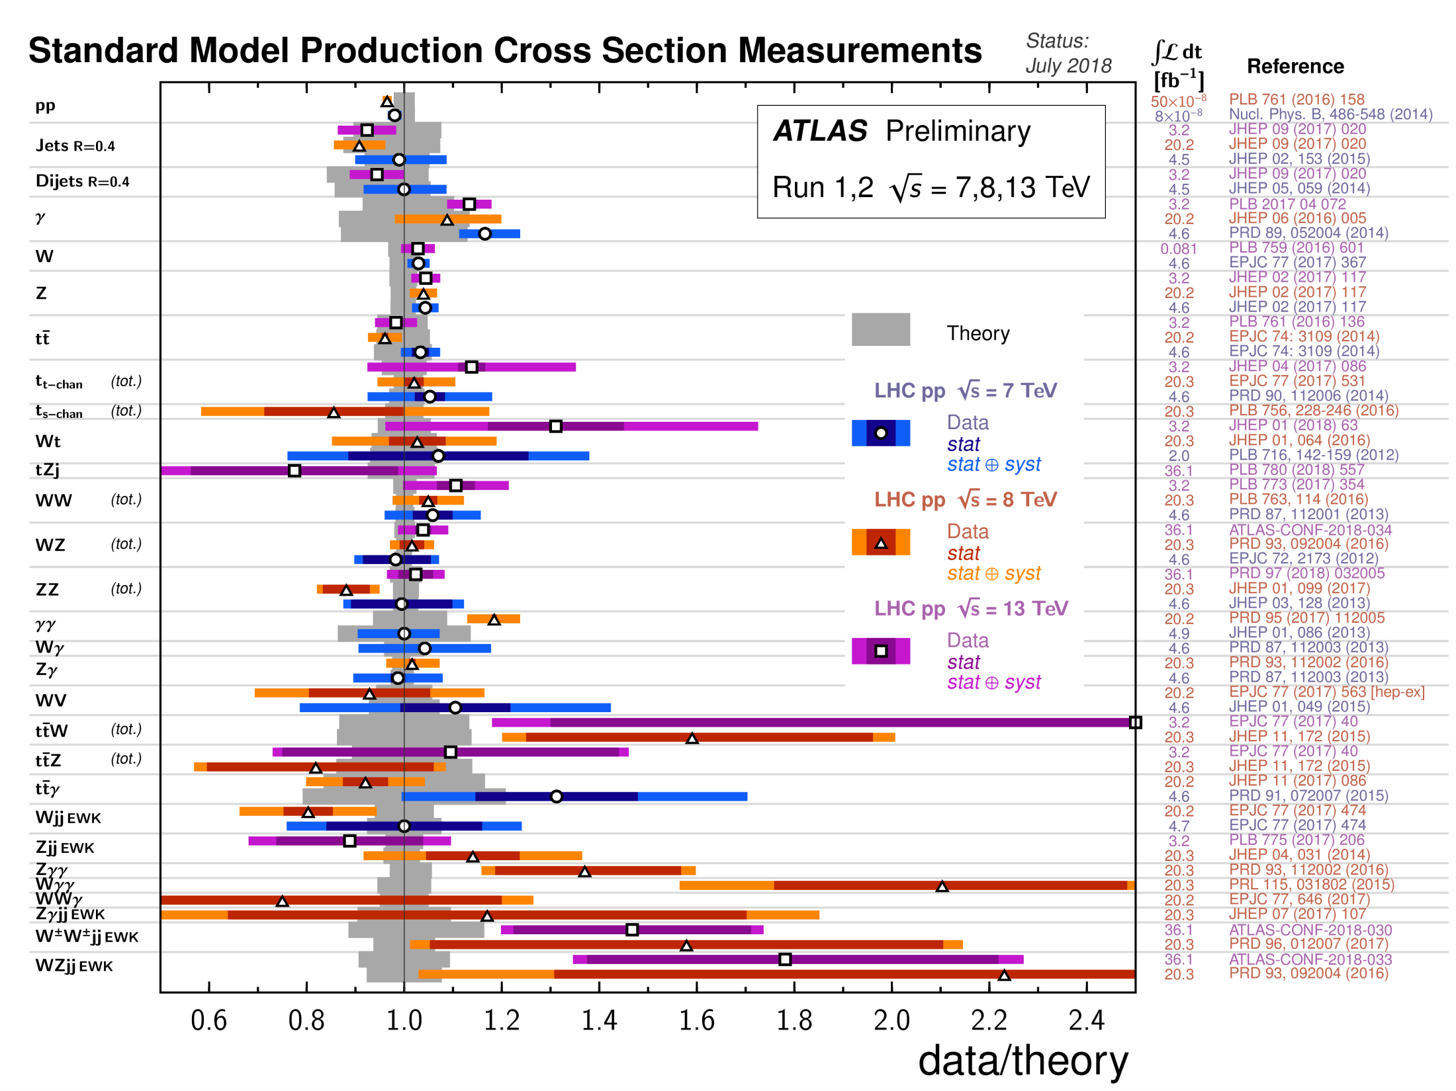
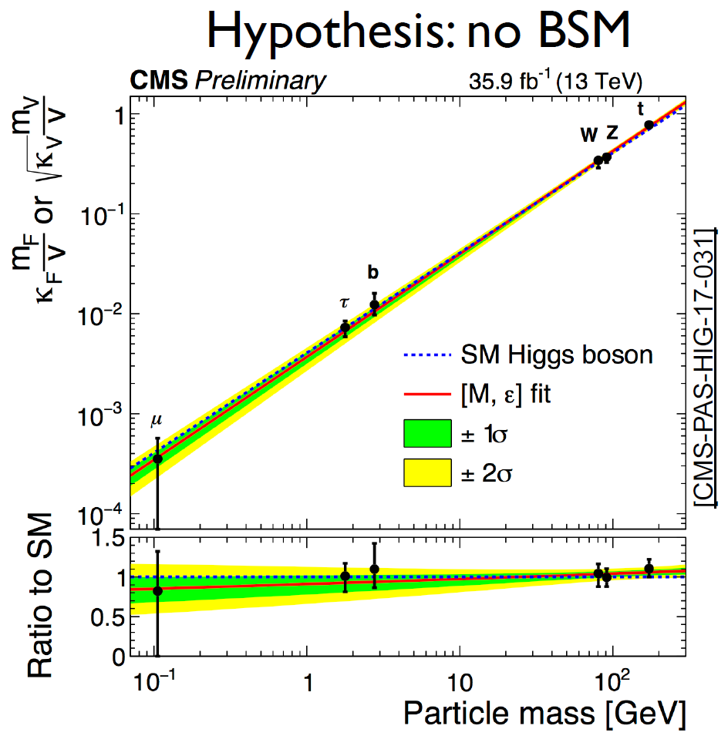

Slide 4
The Standard Model has been described as
‘the unsung triumph of modern physics’
Much of this triumph has been achieved because of the high accuracy measurements at colliders over the years…
partons were discovered at SLAC
the c quark and the τ lepton were discovered at SPEAR
gluons were discovered at PETRA
W and Z were discovered at the SppS
the SM was tested to the quantum level by LEP
the top quark was found at the Tevatron
the Higgs boson was found at the LHC
_
The triumph of the Standard Model is as much a triumph of collider experiments as of QFT and the gauge principle…

Slide 5









Gauge theory
+ P violation
scalar self-interactions
Yukawa interactions
+ CP violation
Parameter count :
2+2+6+(3+1)+6+(3+1)
= 24

Slide 6



The Seven Great Questions
5. Strong CP problem
6. Vacuum Stability
7. Hierarchy Problem
clueless
Dark matter
Dark energy
unexpected
3. Baryogenesis
4. Neutrino Mass
embarrassing
Biggest puzzle of all :
Why is a makeshift theory like the SM so successful?

Slide 7
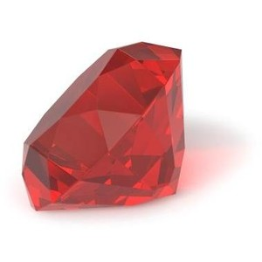
The Five Possible Explanations
Why have we – so far – failed to find any evidence for physics beyond the Standard Model?
The Philosopher’s Stone explanation :
Alchemists spent centuries upon centuries seeking to make the Philosopher’s Stone or Touchstone, which , by a touch would convert inexpensive materials into gold. They failed because there is no such thing, and no such mechanism exists.
There is no new physics – the Standard Model is the final theory. All searches for bSM physics are doomed to fail because there is no bSM physics.
If this is really the case, we cannot ignore the question why such a hastily cobbled-together theory is the final one.
Or is there really an anthropic principle?

Slide 8
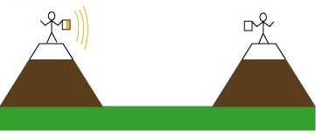
The Five Possible Explanations
Why have we – so far – failed to find any evidence for physics beyond the Standard Model?
The Galileo’s lantern explanation :
Galileo tried to find out how fast light travels by standing on one hill and stationing an assistant with a lantern on another hill some miles away. Galileo would uncover his own lantern, and as soon as the assistant saw its glimmer, he would uncover his… This method failed because light travels much too fast…
There is bSM physics, but it exists at a much higher energy scale than we can achieve, or are planning to achieve.
Can we devise a wholly new kind of experiment which would overcome this deficiency, just as Fizeau and Foucault did for the speed of light ? Do we have a probe of much higher energy scales?

Slide 9

The Five Possible Explanations
Why have we – so far – failed to find any evidence for physics beyond the Standard Model?
The Malaria explanation :
For many centuries, people thought that malaria was due to foul smells..The very name ‘malaria’ comes from ‘mal’ (bad) and ‘air’. People would go around smelling perfumes and covering their noses. Not till Ronald Ross in 1897 was the mosquito found to be the culprit.
There is new bSM physics, but it is not of the kind we have been looking for and we have simply ignored the signals which are very much there.
Can we search in an unbiased way which will catch bSM signals whatever they are?

Slide 10
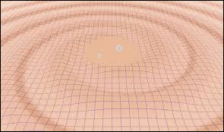
The Five Possible Explanations
Why have we – so far – failed to find any evidence for physics beyond the Standard Model?
The Gravitational Waves explanation :
For almost a century people kept looking for gravitational waves from some sources. These all failed because gravity is so weak. Success only came with vastly improved technology detecting a truly catastrophic cosmic event.
There is new bSM physics, and its signals have been there all along, but these are very feeble and are getting lost in the stronger SM backgrounds.
Can we enhance the S/B ratio is any way?

Slide 11

The Five Possible Explanations
Why have we – so far – failed to find any evidence for physics beyond the Standard Model?
The Uranus explanation :
The planet Uranus was discovered in 1781 by Herschel who saw its disc through his big telescope. It was then discovered that Uranus had been plotted as a star on star charts six times before – but no one had checked those charts to see if anything had moved or not.
There is bSM physics in the existing data, but in our haste to look for familiar things, we have overlooked it, or misinterpreted it.
It is worth taking a hard look again at the existing data, with some kind of unbiased analysis method.

Slide 12

How Can Colliders Help?
Philosopher’s Stone case : If the Standard Model is the only theory, we need to measure its parameters very precisely at different energy scales to discover possible connections/ correlations which could tell us why they have their present values…
Of the 24 SM parameters, the only ones not yet measured are the quartic scalar coupling λ, the neutrino masses m_{ν} and the phase δ_{CP} of the PMNS matrix. More precise measurements may reveal unexpected features.
Colliders are most useful in measuring λ - the others are better measured from non-collider experiments.
Measurement of all parameters at higher scales will test the SM to loop-level and perhaps their running will give a clue to their pattern.

Slide 13

How Can Colliders Help?
Galileo’s Lantern case : If the new physics lies at much higher scales, it will manifest as tiny deviations (at the quantum level) from SM predictions and some rare processes which are bSM… only much more precise measurements and delicate searches can unveil these…
We must continue to measure SM cross-sections and masses to higher and higher precisions, till these effects show up. This can be done effectively only at colliders.
We can (and do) write down effective field theories, using only symmetry arguments, and try to predict bSM effects using higher-dimensional operators – easier said than done.
If we do find nonzero Wilson coefficients of these HD operators, we will look for correlations between them which might indicate the underlying physics.

Slide 14
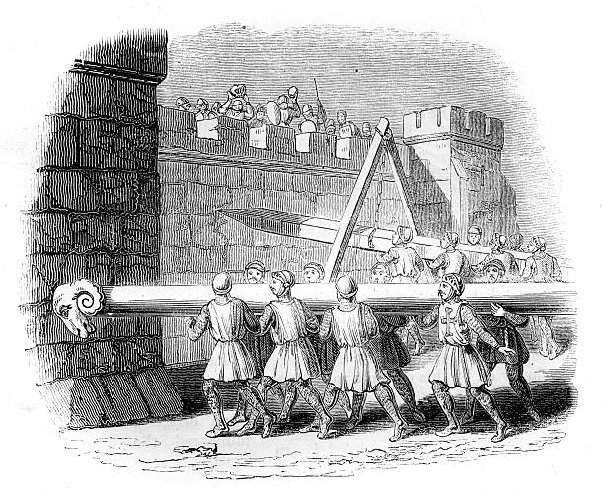
How Can Colliders Help?
Malaria or Uranus case : Perhaps we will have to discover the bSM signals by a combination of better technology and serendipity, and only then will we be able to identify the signals which are already present…
We must go to higher energies and luminosities to pick up the signals for new physics. This can be done most effectively at colliders.
We can build discovery machines – hadron collider like the LHC – as well as precision machines – lepton colliders like LEP.
If we do find bSM physics at higher energies, we may then be able to extrapolate to current energies and luminosities to see what we have missed. Admittedly an academic exercise.

Slide 15

How Can Colliders Help?
Gravitational Waves case : If we are lucky, bSM physics may be just around the corner, but perhaps not in any of the forms we have been expecting…
We need to go on running the LHC and to build precision machines in the same energy ballpark. Only if enough data accumulate can we at all think of filtering it for very rare events.
Theorists need to devise more unbiased search techniques which would throw up new effects with as small a data sample as possible.
If we do find bSM physics signals at, e.g., the LHC, the stage will be set for the next generation of colliders to probe this new physics.

Slide 16











What Kind of New Colliders are Being Contemplated?
HADRON
Colliders
Lepton Colliders
γγ
Laser
Plasma
Fields

Slide 17
Lepton vs Hadron Colliders
Lepton Colliders
HADRON
Colliders
Leptons in circular storage rings have enormous energy loss from synchrotron radiation; must use linacs
Ramping up energy requires very long machine
Each bunch crosses just once : high luminosity is a challenge
Large e/m allows focussing into very intense bunches
Protons/antiprotons are easy to hold in circular storage rings because of the low energy loss from radiation (~ m⁻⁴)
Ramping up energy through multiple RF cavities is possible
Bunches cross hundreds of times leading to high luminosity
Focussing protons is difficult because of the low e/m ratio

Slide 18

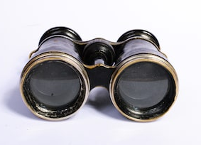
Lepton vs Hadron Colliders
Lepton Colliders
HADRON
Colliders
Only electroweak cross-sections are available
Charge conservation restricts final states
Fixed CoM energy
Relatively clean environment
Can produce particles through strong interactions – huge cross-sections
Wide variety of processes occur, both CC and NC
Indeterminate CoM energy
Lots of junk

Slide 19
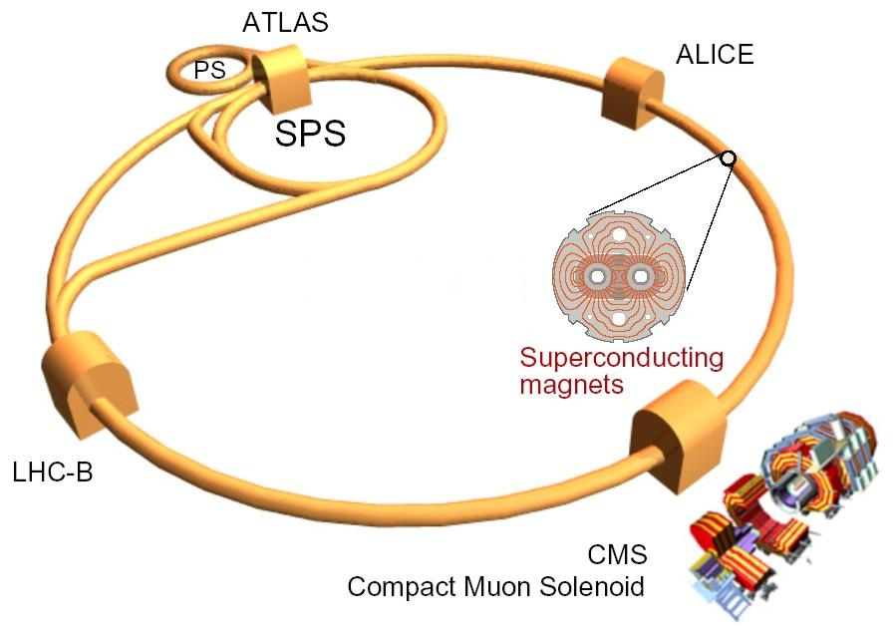


Precision
Energy
Luminosity

Slide 20
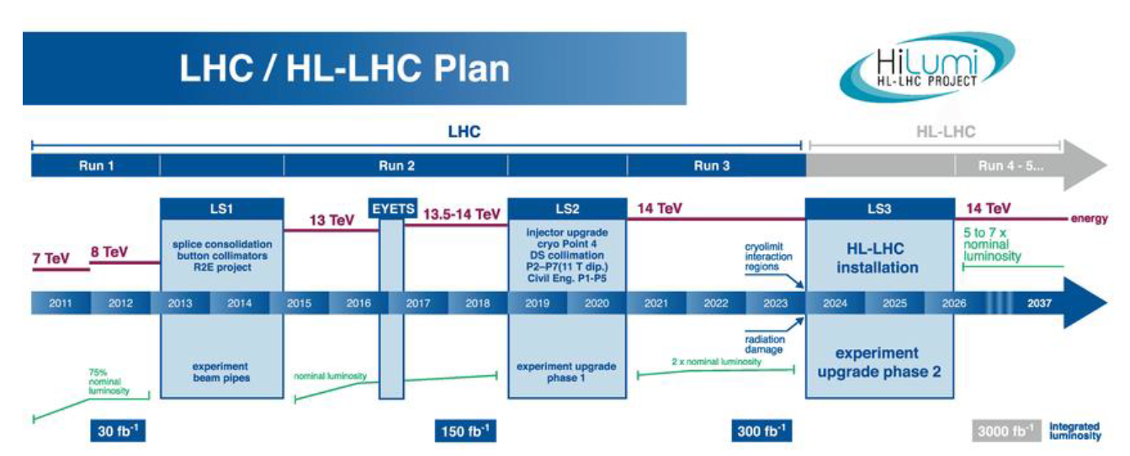
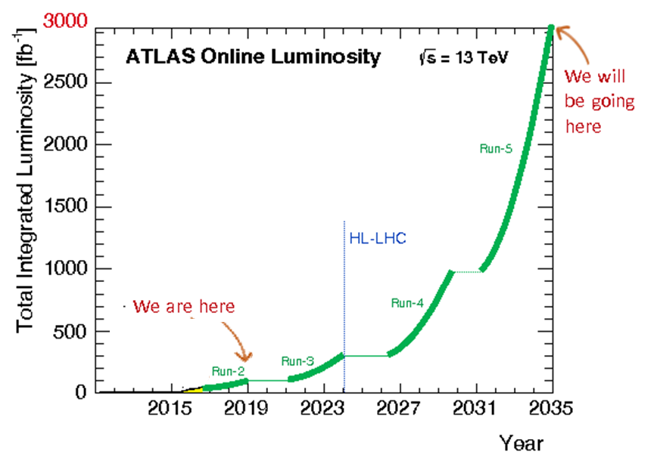
The High Luminosity-LHC
Run 1 collected around 30 fb⁻¹ at 7 – 8 TeV
Run 2 collected around 150 fb⁻¹ at 13 TeV
Run 3 will collect around 300 fb⁻¹ at 14 TeV
Run 4 will collect up to 1000 fb⁻¹ at 14 TeV
Run 5 will collect up to 3000 fb⁻¹ at 14 TeV

Slide 21
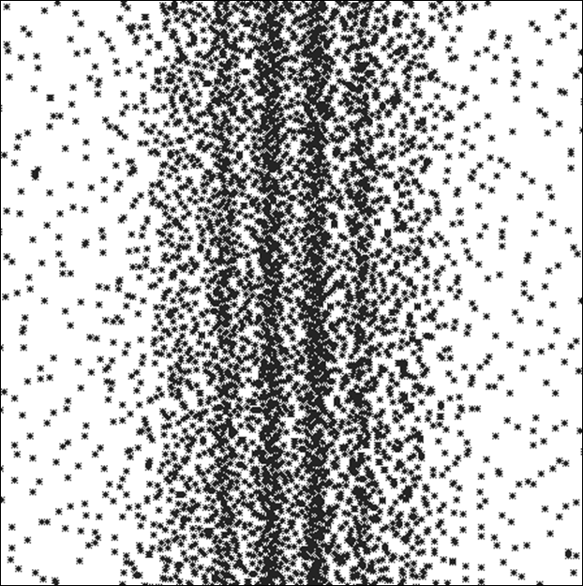

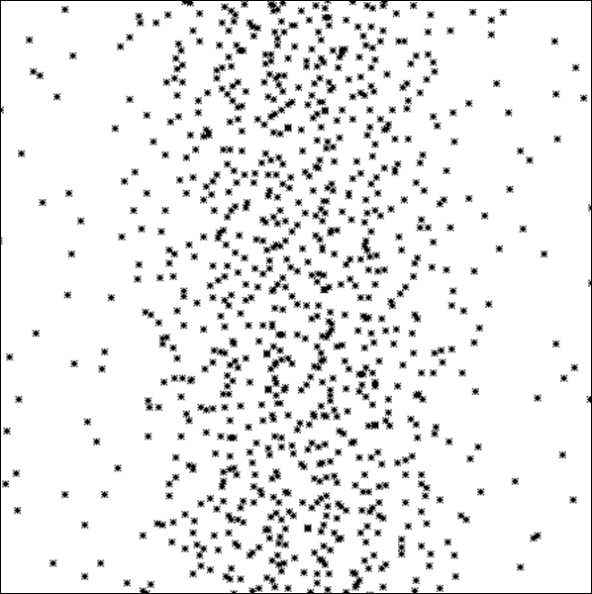
100
1000
5000
There is still plenty of scope for unknown physics or unknown phenomena to appear at the HL-LHC…

Slide 22
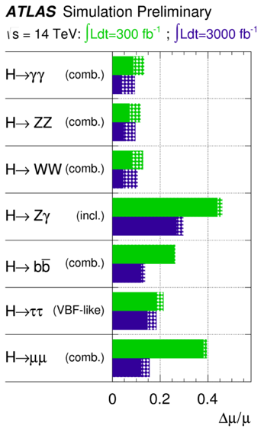
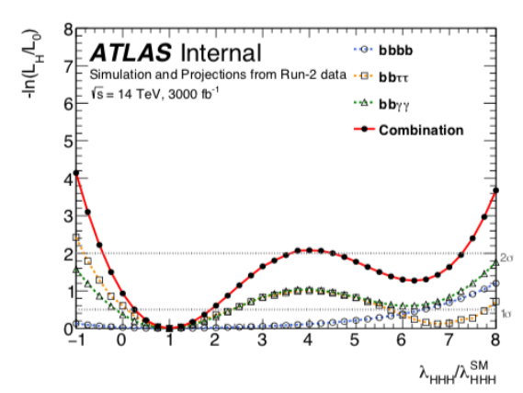

Precision measurement of Higgs parameters…
self-coupling
Not much hope
The Higgs self-coupling is vital for the future of the Universe
ATL-PHYS-PUB-2014-016

Slide 23
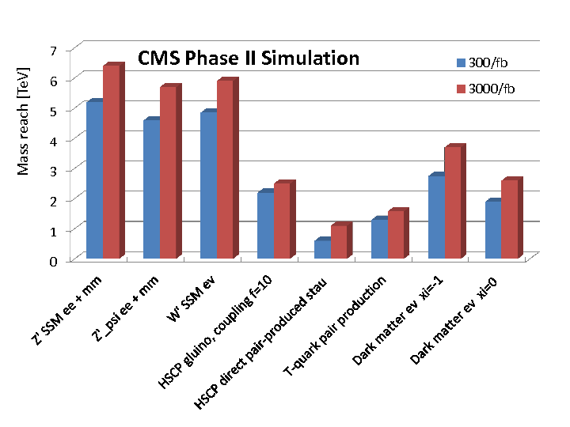
Increase in the discovery range is rather moderate…

Slide 24
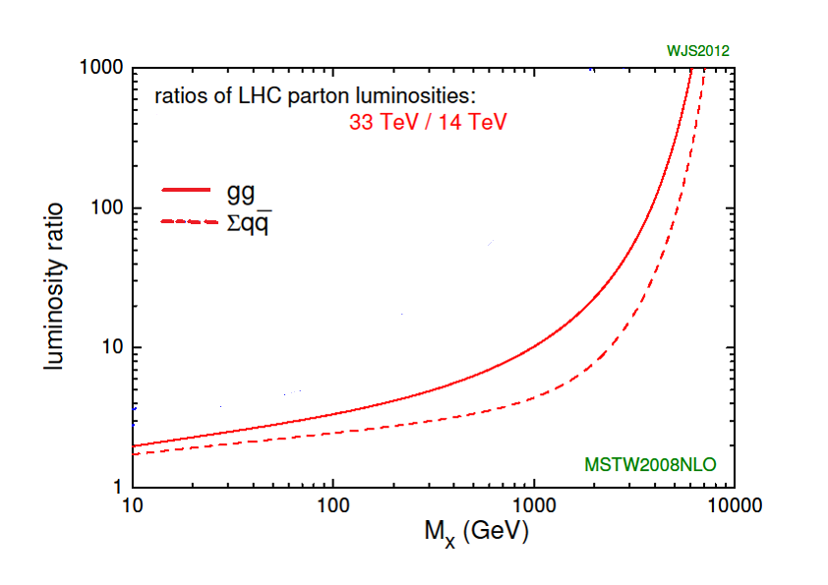
Luminosity Upgrade VS Energy Upgrade
2.36
Bump hunting

Slide 25
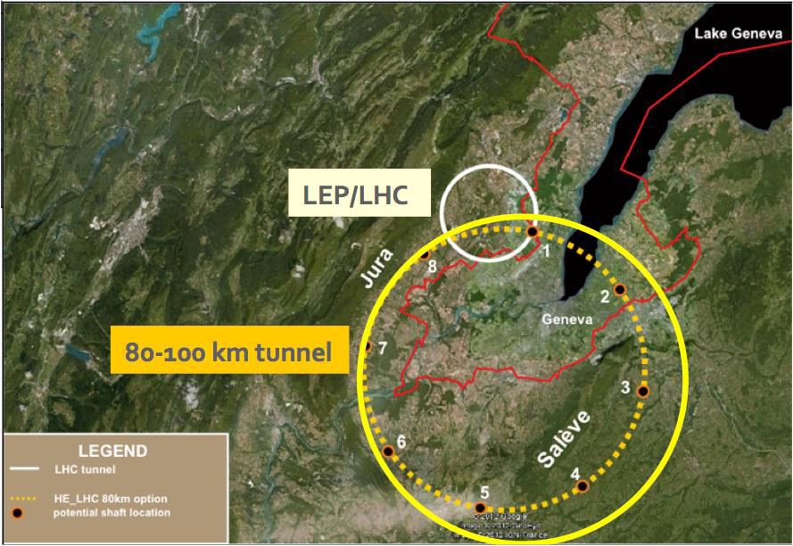
The High Energy-LHC or very LHC or FCC-hh

Slide 26
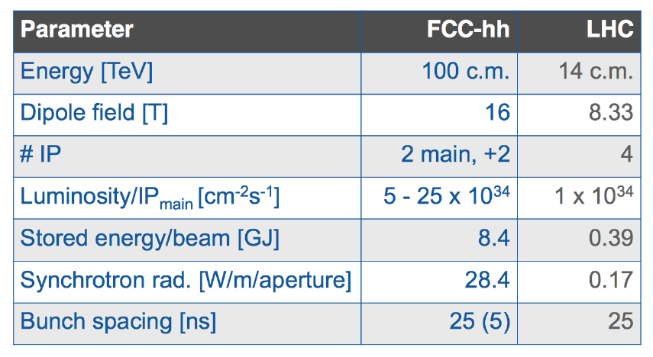
The High Energy-LHC or vLHC or FCC-hh
Many more accelerating RF cavities
Stronger bending magnets (superconducting)
Luminosity:
Run-1 2.5 ab in 10 yr ; Run-2 15 ab in 15 yr ; Run 3 40 ab in 25 yr

Slide 27
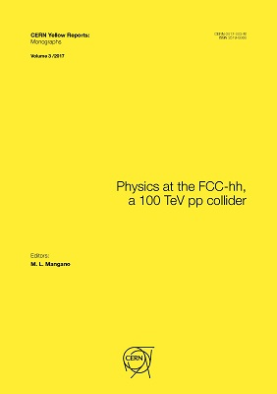
Analysis is made under the following assumptions:
Signal and background scale in the same way
Reconstruction efficiencies, background rejection, etc. remain the same
Cross sections remain proportional to parton luminosity
Major caveats:
We do not know if there are new physics thresholds at some intermediate energy
All SM particles will appear massless: W, Z, H, t will just appear as jets
We do not know how the parton luminosity scales
(cosmic rays)

Slide 28
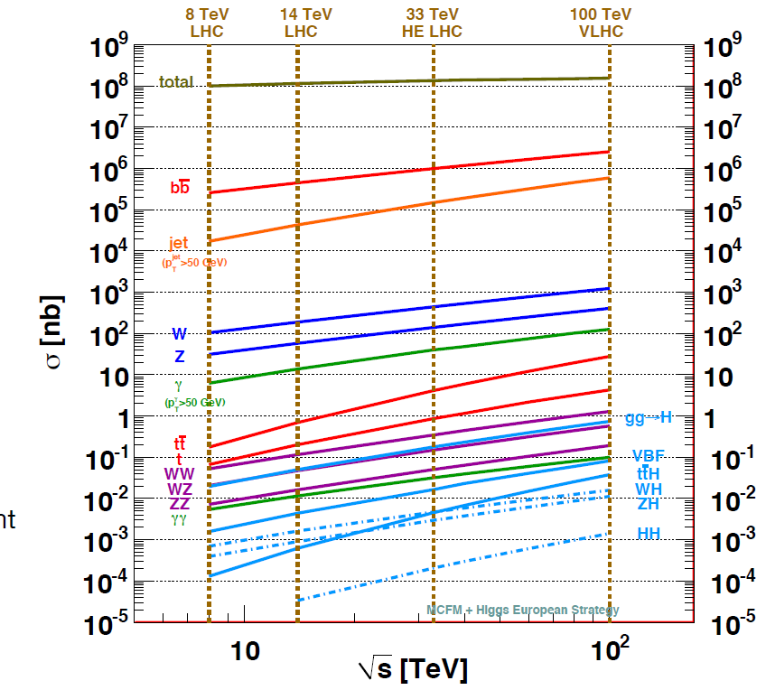

Slide 29
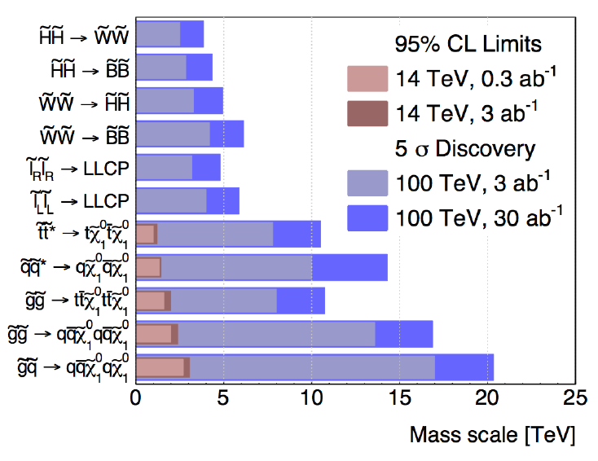
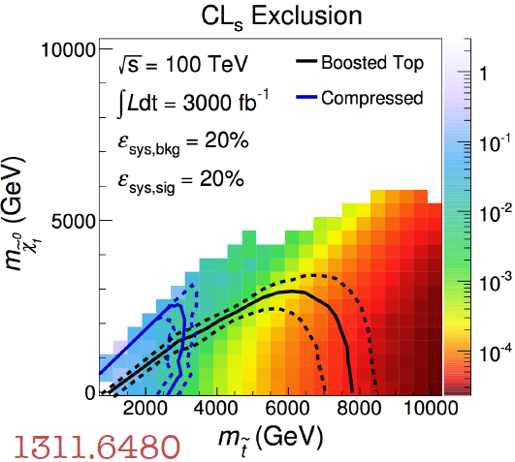

Slide 30
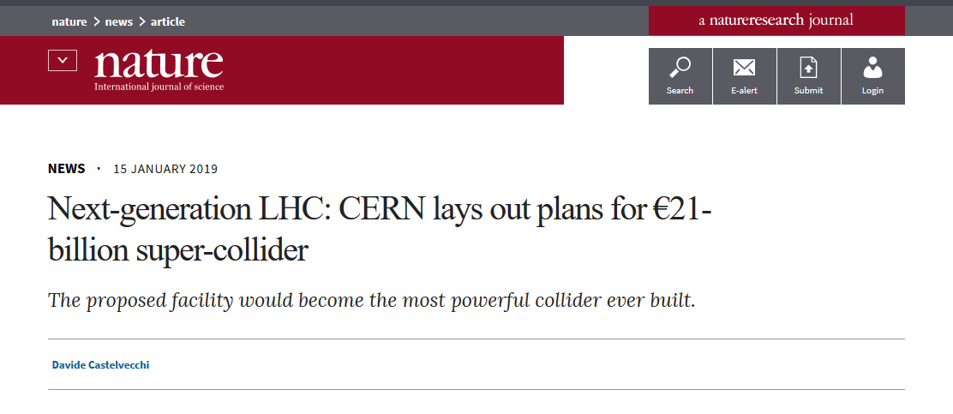
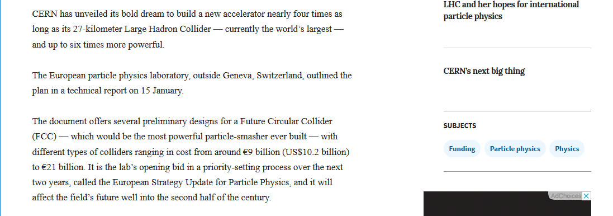
2040 – 50

Slide 31
The International Linear Collider (ILC)
The idea of a linear collider was to follow up on discoveries made at the LHC.
This would be in the same way as the W, Z were discovered by hadron machines and then their properties were measured at LEP-1 and LEP-2.
With the Higgs as the only discovery made at the LHC, the entire LC programme is now is jeopardy.
Proposal to go ahead and build it anyway, irrespective of LHC results or to measure Higgs properties.
Physics case must be strong enough.

Slide 32
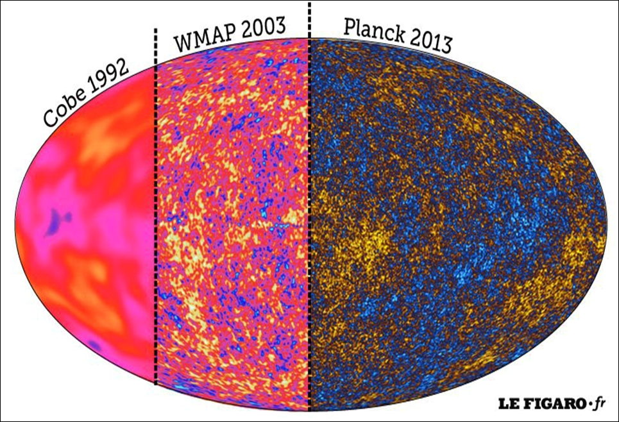
Precision matters!

Slide 33
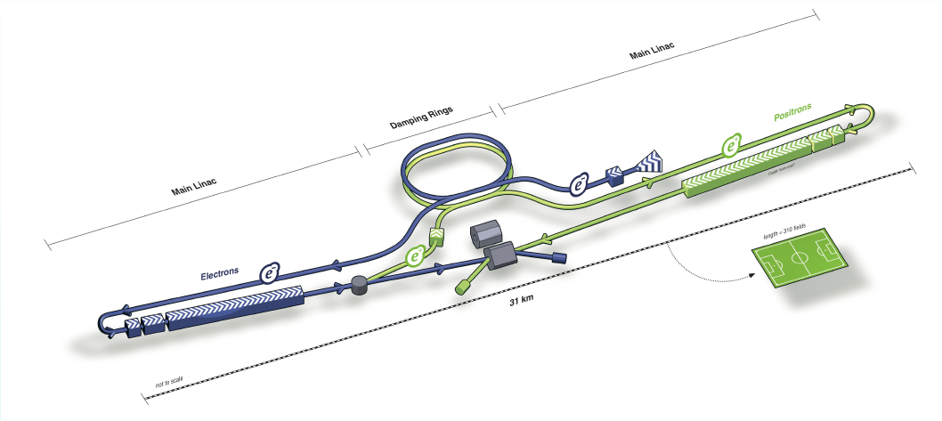
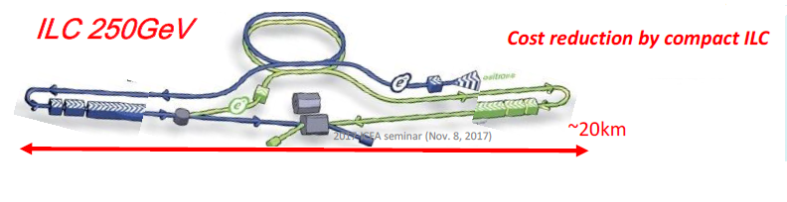
The International Linear Collider (ILC)
31 km long
500 GeV
20 km long 250 GeV

Slide 34
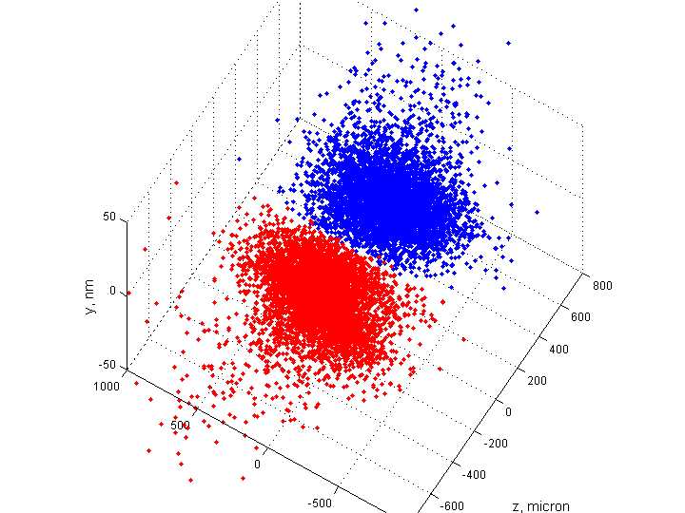
The International Linear Collider (ILC)
The energy can be ramped up at a linear collider simply by making it longer and putting in more and more accelerating cavities.
The only radiation is forward-peaked (bremsstrahlung) and will not spread out. Hence a LC can be build on the surface and does not need a deep underground tunnel.
Major disadvantage is that bunches cross only once; to increase luminosity, we must make the bunches very small and dense.
Very dense bunches tend to destabilise due to (a) internal fields and (b) beam-beam interactions.
Simulation made with GUINEA-PIG software

Slide 35
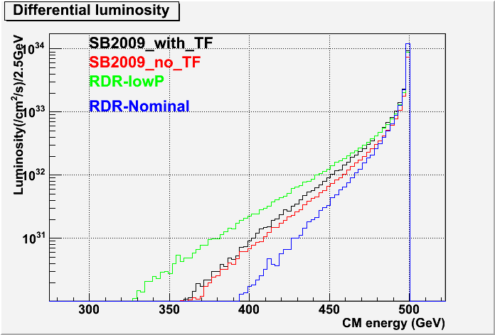
The International Linear Collider (ILC)
At the ILC, there will be a spread of C-o-M energies, like a h.c., due to ISR + beamstrahlung… but it also acts as a γγ collider

Slide 36
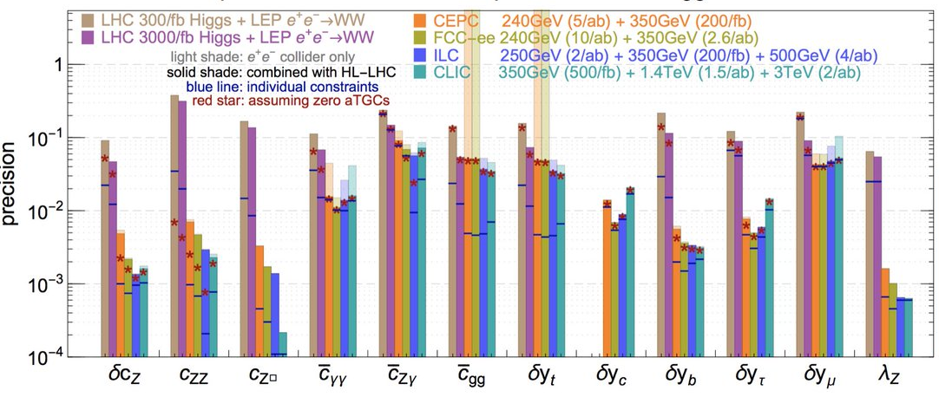
The International Linear Collider (ILC)
Higgs couplings can be measured with much better precision
Will throw light on :
Electroweak symmetry-breaking (are masses ∝ couplings)
New physics in Higgs couplings

Slide 37
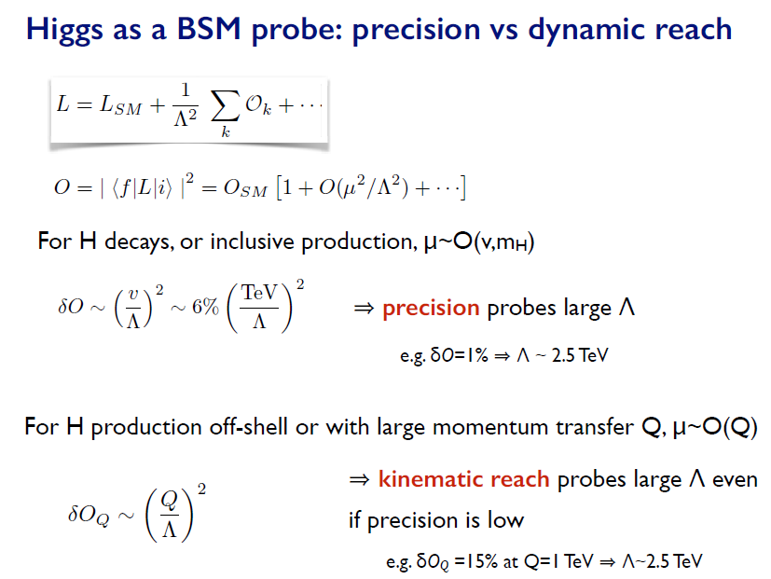
The International Linear Collider (ILC)
M.Mangano @LUND (2016)

Slide 38
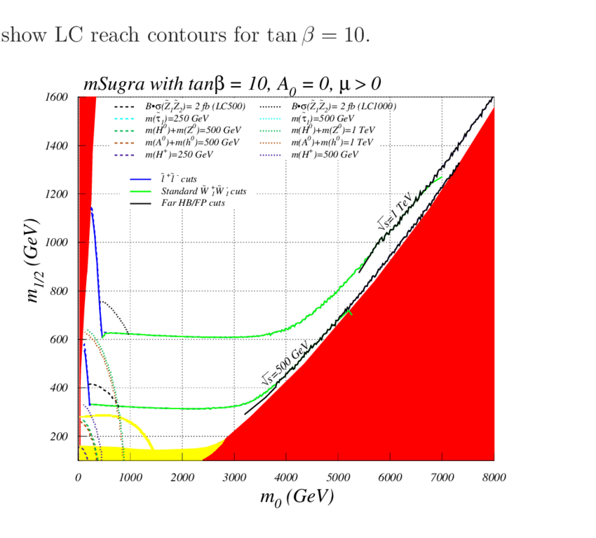
The International Linear Collider (ILC)
HL-LHC
LHC-Run1
As a discovery machine, the ILC is hardly competitive with the LHC

Slide 39

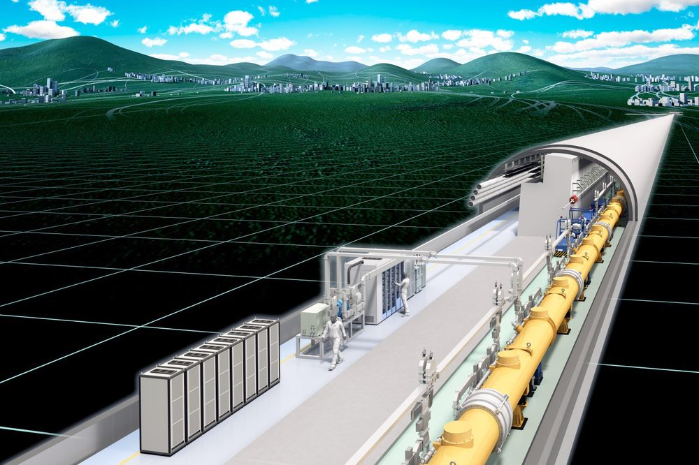
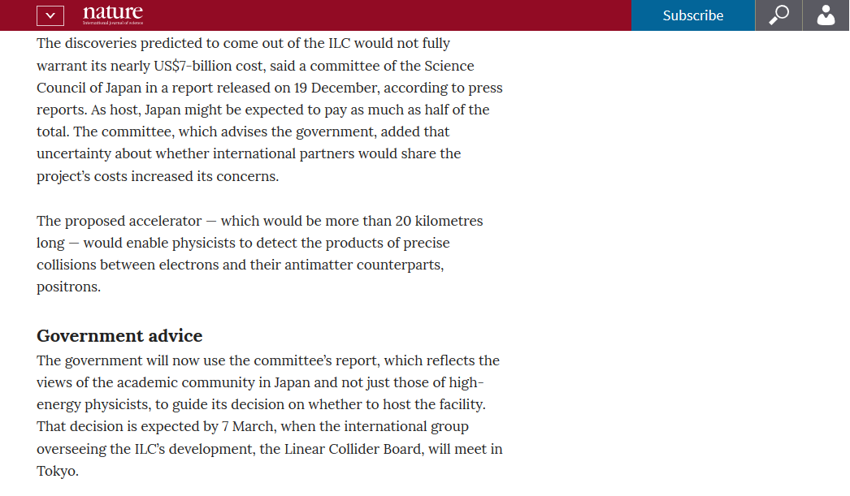
The International Linear Collider (ILC)

Slide 40
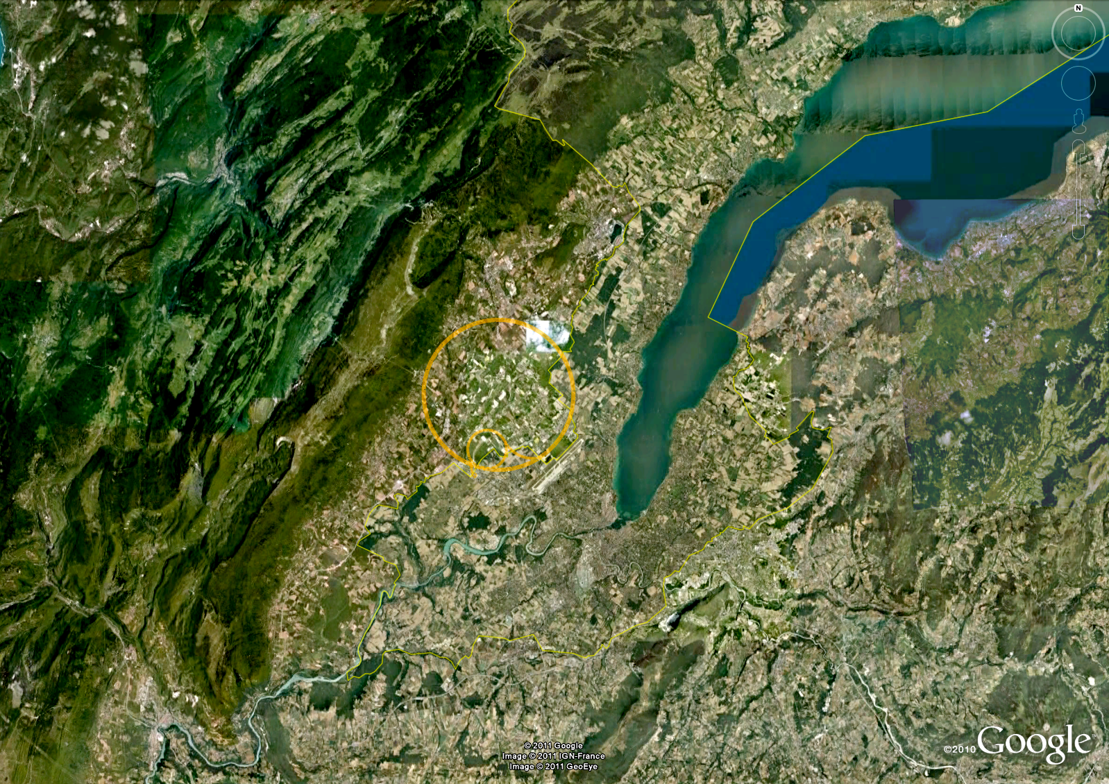
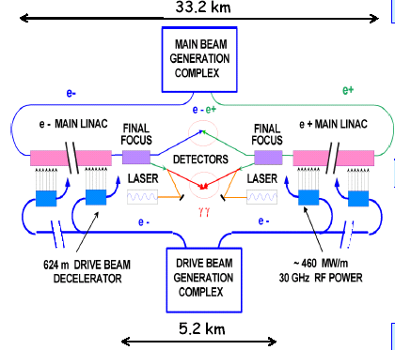
The Compact LInear Collider (CILC)
C-o-M energy = 380 GeV
C-o-M energy = 1.4 TeV
C-o-M energy = 3 TeV
CLIC uses a two beam system to achieve gradients of 150 MV/m
A high-current low-energy drive beam transfers RF power to the main beam
Operates in 30 GHz region, with normal conducting accelerating structures

Slide 41
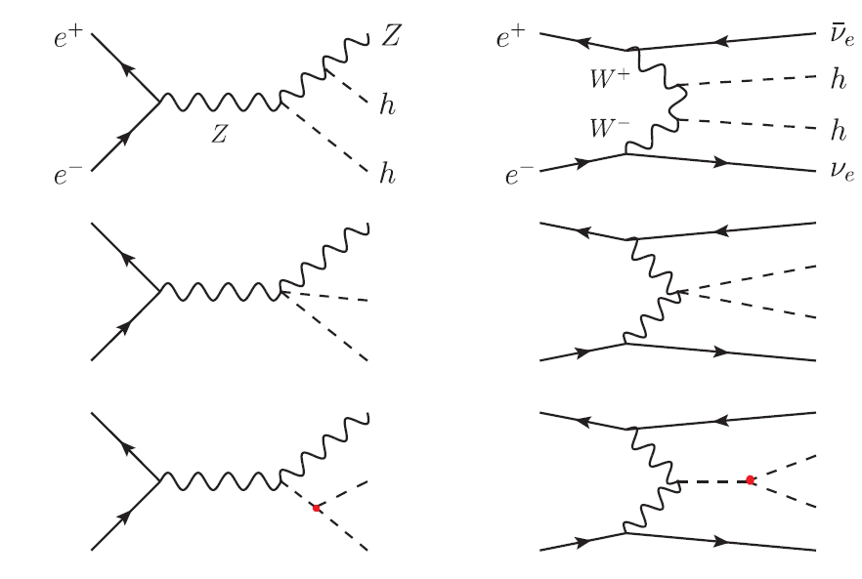
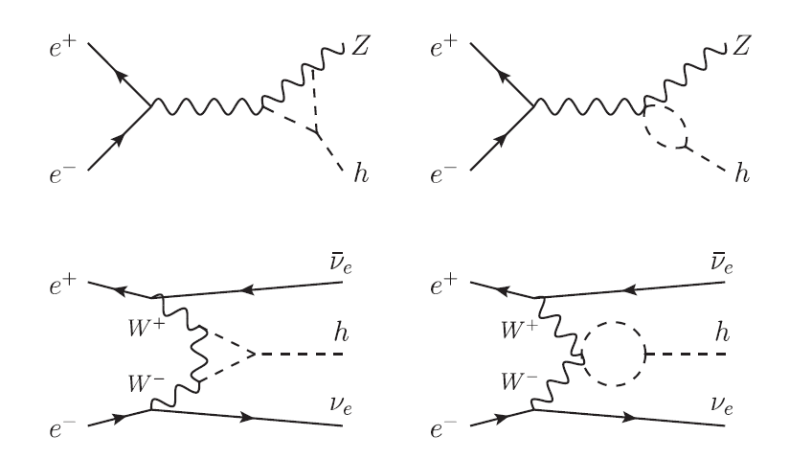
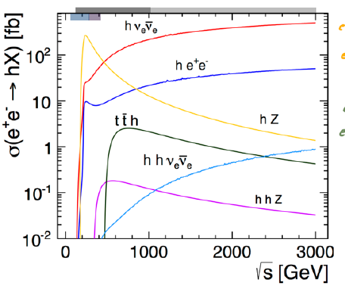

The Compact LInear Collider (CILC)
1,2,3 Higgs production through VBF becomes dominant

Slide 42
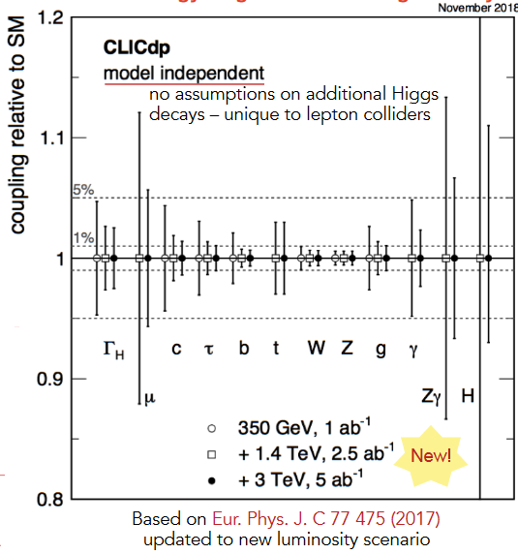
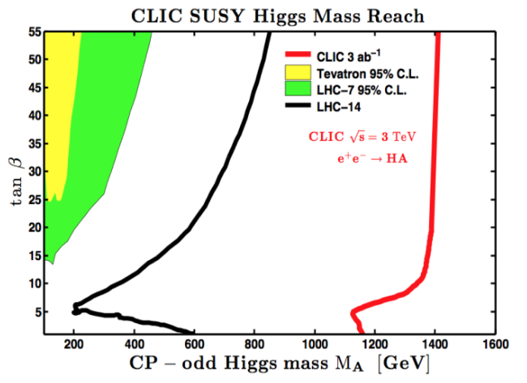
The Compact LInear Collider (CILC)
CLIC will have more discovery potential than the 13-14 TeV LHC… just because of the increased energy…

Slide 43




The Circular Electron-Positron Collider (CEPC)
The Super protron-protron Collider (SppC)
Wang Yifang
Bohai Sea

Slide 44
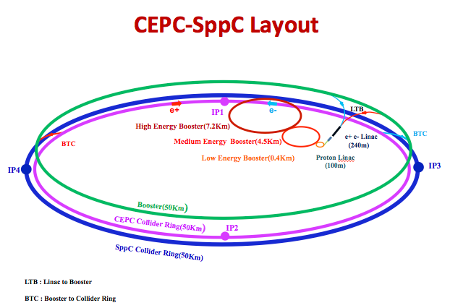
In the first phase CEPC will run at 350 GeV – 1 TeV
In the next phase SppS will run at 60 – 100 TeV

Slide 45
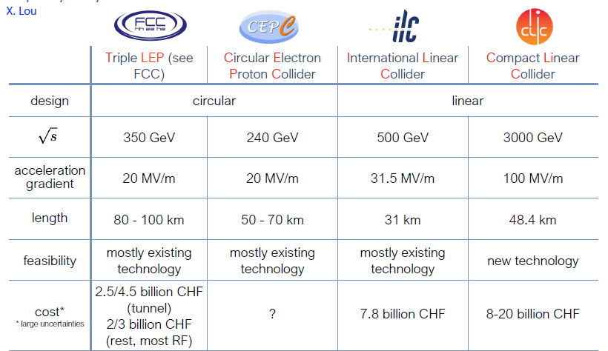
Comparison of Lepton Colliders

Slide 46
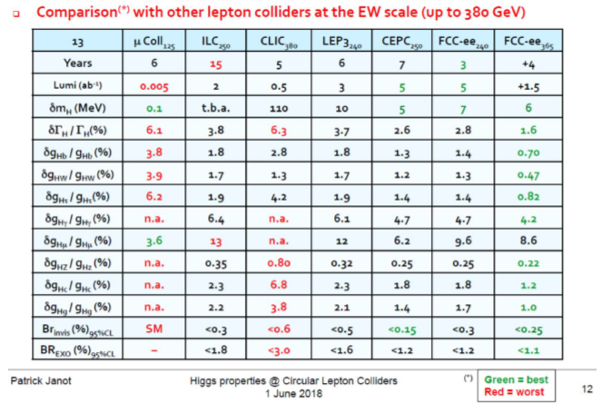
Comparison of Lepton Colliders

Slide 47

Wang Yufang April 2018

Slide 48
Muon Colliders (μC)

Slide 49
Muon Colliders (μC)
Muon coupling to Higgs boson is around 0.00043
Can still make a Higgs factory by tuning to Higgs mass resonance
Smaller circular collider easy to make because muon mass is about 207 times electron mass
Synchrotron radiation is negligible
Time dilation keeps the muons quasi-stable so that many bunch-crossings can be achieved
Beam cooling is difficult because muons decay
No clear solution found yet

Slide 50
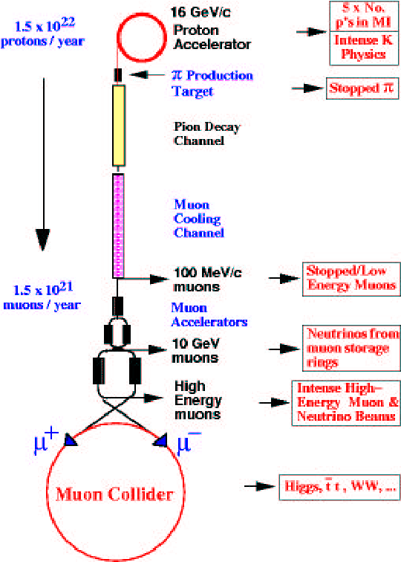
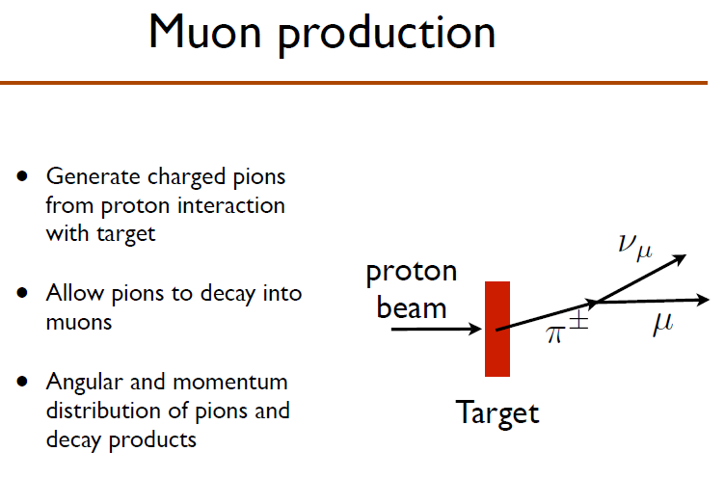
Muon Colliders (μC)
Not so difficult to produce…

Slide 51
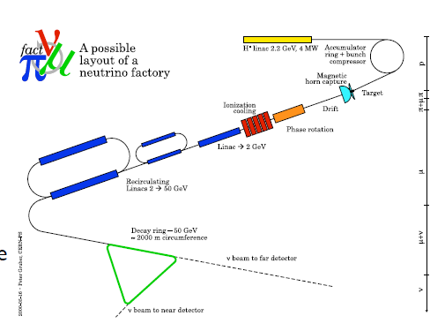
Muon Colliders (μC)
Muons decay into electrons and neutrinos ⇒ ν factory

Slide 52


Muon Colliders (μC)
What muon colliders do best is to measure the width of the Higgs boson to an accuracy impossible at electron-positron machines…
Discovery potential is very similar to other lepton colliders
when E and L are increased

Slide 53


Laser Plasma Acceleration
Every time a charged particle passes through one of these cavities, it gets an acceleration due to a correctly-aligned electric field (hence RF). But max field is about 100 MV/m, before breakdown.

Slide 54

Laser Wakefield Acceleration
A plasma can support electric fields as high as about 100 GV/m – 1 TV/m. If a cavity contains a plasma, energy imparted can be few 100 GeV per cavity, instead of 100 MeV per cavity.
Potential to create a high energy tabletop accelerator!
A plasma in equilibrium does not have these high fields. But if, e.g. a projectile passes through the plasma, the plasma will oscillate in the wake of the projectile.
These wake oscillations create regions of very high plasma density, where the 100 GV/m strength fields occur.
Instead of a projectile, use a short but powerful laser pulse
Electrons are trapped in the plasma and shot out by the wakefield. Timing has to be just right.

Slide 55

Laser Wakefield Acceleration
Very promising technology
Being vigorously pursued all round the world
Still to achieve really high energies

Slide 56
Other Colliders
ep colliders, e.g. LHeC
  Good for measuring PDFs accurately
  Can create leptoquark resonances
  Other attributes depend on E and L
ee colliders
laser-backscattering colliders – eγ and γγ
  Good for studying gauge bosons
  Discovery machine for diphoton resonances
  Other attributes depend on E and L

Slide 57
The Ultimate Collider
Maximum possible electric field is the Schwinger limit, i.e. 1.32 x 10¹² MV/m
Using such fields, a linear collider can reach Planck scale, i.e. 1.2 x 10²² MeV if its length is
around 10⁷ km
i.e. just 1/100 of the Earth-Sun distance…
Perhaps it can be built one day by a technologically advanced human race…

Slide 58


Thank You

